Slide 1







Leveraging OUHSC Clinical Data Warehouse to Inform Research & Practice
Will Beasley, PhD
Ashley Thumann, MHA
Wale Oluborode, MD, MPH
David Bard, PhD
University of Oklahoma HSC
Biomedical & Behavioral Methodology Core (BBMC)
June 2020
Award Numbers: UG1OD024950 U54GM104938
Notes:
Hi I’m Will, and part of the Clinical Data Warehouse effort on campus. I started as a conventional statistician and researcher, and based on experience with integrating our investigations with state agency data , our group moved into the world of EMRs and CDWs.
I think these experiences have allowed our group to relate well with current PIs, as well as build a CDW ecosystem that works well with research.

Slide 2
Terms
EMR (or EHR): Electronic Medical/Health Records A huge database with patient records used by providers
CDW: Clinical Data Warehouse A collection of databases (such as EMRs and project-specific datasets) that has been transformed to make research more efficient and complete
Notes:
Here are the data sources for the research projects that we’ve assisted with. Roughly in descending order of frequency.
Most of our projects involve inpatient EMRs, outpatient EMRs, and billing systems.
In some ways, our experience started with datasets from external collaborators, such as the Dept of Health, and grew from there.

Slide 3
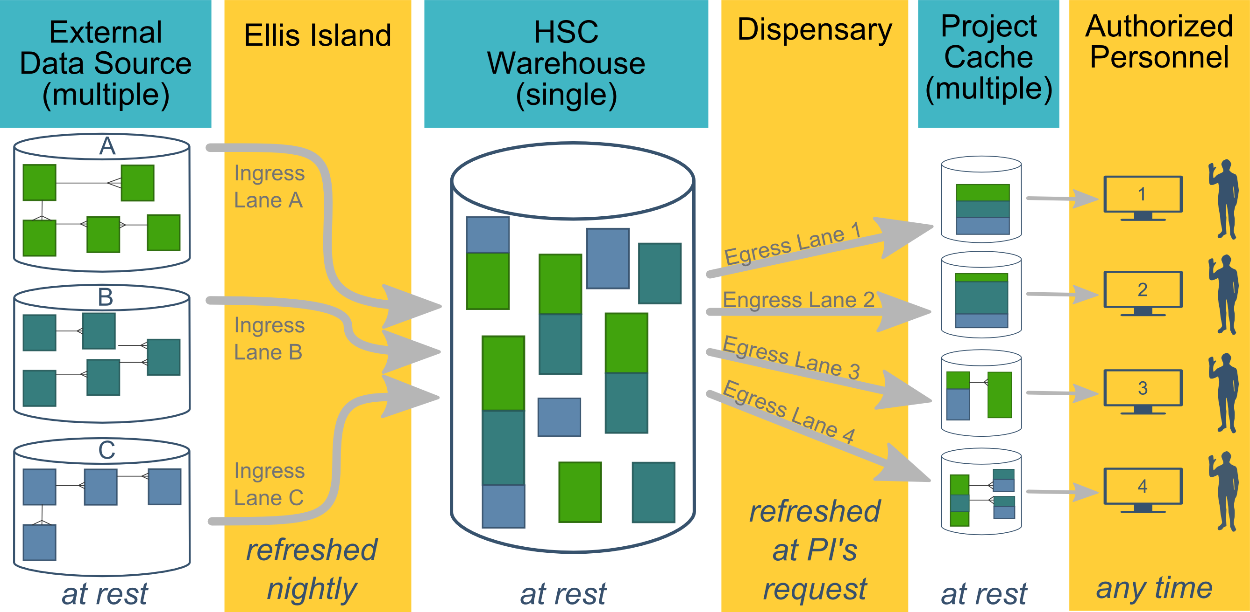
Ecosystem Architecture
Prairie Outpost – CDW (Clinical Data Warehouse)
https://github.com/OuhscBbmc/prairie-outpost-public
Data Source (column 1): contains unique info
Warehouse (column 3): contains copy after manipulation
Project Cache (column 5): contains copy of copy after a lot of manipulation
Notes:
The entire ecosystem can be represented by these six columns. The EMR and other collection databases sit in the 1st column and feed the warehouse in the third. This movement is automated. Inside the warehouse, the info from the different sources are staged & combined. Different patients can be placed in the same table. Perhaps more importantly, records for a single patient that are scattered across different sources are linked.
When a investigation is approved by the IRB, we can develop a tiny database in REDCap that contains the dataset needed for their analysis (5th column). There are a few reasons why REDCap is preferred. First, it’s more secure and scalable than distributing loose Excel files repeatedly for the same project. Second, REDCap has a lot of momentum and adoption, so it’s become familiar to a lot of people on campus --like those using it to collect research data.
We’ve always emphasized that we developed this to be as modular as possible. If someone could benefit from a few columns, they don’t have to commit to the whole thing. This modular approach has paid off, and I’ll return to that in the last few slides.

Slide 4
HSC Data Sources
Patient
Outpatient (Centricity)
Billing and Claims Data
Inpatient (Meditech)
Dozens of departmental sources
Biomedical Research Data
Epic (in ~1 year)
Provider
External Agencies
Service Provided (by the Health Dept of Oklahoma)
Child Protective Services (Oklahoma Dept of Human Services)
Immunization (Health Dept of Oklahoma)
Vital Records (Health Dept of Oklahoma)
…
Multi-state collaborations (in the future)
Administrative Cost
Employee & Student
Notes:
Here are the data sources for the research projects that we’ve assisted with. Roughly in descending order of frequency.
Most of our projects involve inpatient EMRs, outpatient EMRs, and billing systems.
In some ways, our experience started with datasets from external collaborators, such as the Dept of Health, and grew from there.

Slide 5
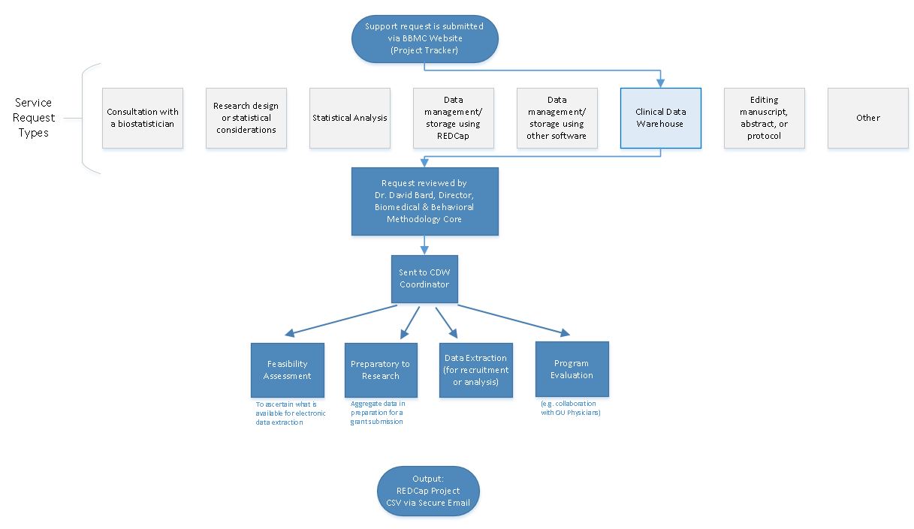
Typical Workflow for a
CDW Research project
by the BBMC
Submit a request at:
ouhsc.edu/bbmc/
then ‘Request Support’
Notes:
Our group, the BBMC, is a core of ~6 faculty statisticians and another ~10 staff with skills in health administration, analysis, research, and data science.
When we receive a request involving the CDW, it’s reviewed by a triage team and assigned to a mix of people. We assist with the project (ideally while the proposal is being written –not after it’s submitted). Some of the time we’re also the statisticians, and some of the time the PI has their own statistician or is collaborating with a group like Julie’s.
For a one-time retrospective research project, the output is usually a secured CSV. For a project requiring rolling enrollment, we deploy updates every morning with REDCap and dynamic html reports.
I have few friends managing the CDWs of other universities. When we compare our situations, the biggest differences arise from the fact that our CDW was created by a group that’s primarily statisticians & researchers, as opposed to being created by an IT group that brings in outside statisticians. Pros & cons to each origin story. If you see differences between our approach and other institutions, this is a big reason.

Slide 6
Clinical Trials & Other Research Studies Supported by the CDW since 2017; page 1
Short Name | PI | Department
Asthma Outcomes | M. Naifeh | Pediatrics
Pediatric Diabetic Ketoacidosis | M. Marin | Pediatrics
Anxiety & Depression Education | A. Bax | Pediatrics
Obesity in Foster Care | N. Torres-Garcia | Pediatrics
Posterior Cruciate Ligament Avulsions | S. Algan | Orthopedics
Avulsion Fractures (Tibia & Fibula) | S. Algan | Orthopedics
Avulsion Fractures (Femur) | S. Algan | Orthopedics
STI Screening | R. Leasure | Infectious Disease
Interstitial Cystits Pain | L. Quiroz | Women's Health
Pharmacist-Led Care | T. Truong | Pharmacy
POPS | C. Allen | Pediatrics
NAMCS | S. Gillaspy | Pediatrics
Preschool Behavior | A. Bax | Pediatrics
Psychology Consults | S. Gillaspy | Pediatrics
Chronic Hypertension in Pregnancy | R. Edwards | Women's Health
High Blood Pressure in Children | N. Connolley | Pediatrics
Sickle Cell Disease Transition Program | A. Sinha | Pediatrics
Molecular Alterations in Brain Tumors | J. Battiste | Cancer Center
Pelvic Floor Disorders | L. Quiroz | Women's Health
Cancer Patient Navigation Program | J. Vidrine | Cancer Center
Medical Homes for Youth in Foster Care | S. Gillaspy | Pediatrics
Short Name | PI | Department
Subtalar Arthrodesis | A. Haleem | Orthopedics
Pulmonary Hypertension | H. Bhardwaj | Cardiovasular
Pelvis & Acetabulum Fractures | D. Teague | Orthopedics
Spica Casting | W. Puffinbarger | Orthopedics
Fragile X Syndrome | L. Ethridge | Pediatrics
Splinting with Side Struts | T. Lewis | Orthopedics
Humeral Fractures | D. Chong | Orthopedics
Child Trauma Services | E. Risch | Pediatrics
Humeral Fractures | D. Teague | Orthopedics
Asthma Population Management | D. Hahn | Pediatrics
Tobacco Exposure in Pediatrics | S. Gillaspy | Pediatrics
Utility of Chest X-Rays for Asthma in the ED | A. Bogie | Pediatrics
OxyContin Study | D. Hahn | Pediatrics
Transition of Care Clinic | T. Truong | Pharmacy
Lipid Screening | S. Gillaspy | Pediatrics
Sickle Cell Port Placement | A. Sinha | Pediatrics
Tranexamic Acid in Ankle Replacement | A. Haleem | Orthopedics
Newborn Metabolic Screenings | J. Lees | Pediatrics
Scapula Fractures | C. Pasque | Orthopedics
Adrenal Insufficiency | J. Lim | Endocrinology
Brain Metastases with Ovarian Cancer | J. Gillen | Cancer Center
Sever's Disease | S. Algan | Pediatrics
Notes:
Here’s a quick list of the CDW projects so far. Some were wrapped up in less than a day. Some, like POPS, have been ongoing for 1.5 years.

Slide 7
Clinical Trials & Other Research Studies Supported by the CDW since 2017; page 2
Short Name | PI | Department
Brain Tumor Database | S. Sung | Cancer Center
Immunization Data Restructure | D. Bratzler | OUP
Off-Label Drug Use in Children | C. Allen | Pediatrics
Continuity of Care | P. Darden | Pediatrics
Prescribing Practices for Psychotropic Medications | S. Gillaspy | Pediatrics
Lactation Services for Diabetic Mothers | B. Mannel | Women’s Health
Supplementation of LPI | J. Dilley | Women’s Health
PCOS in Psoriasis | P. Allen | Dermatology
Assessment of Medication Problems | T. Truong | Pharmacy
Cancer Genetic Syndrome | J. Walker | Cancer Center
Maternal Depression Screening | M. Dunlap | Pediatrics
PROSpect Study | E. Henry | Pediatrics
Behavioral Health in the ED | R. Johnson | Pediatrics
Stem Cell Transplant Study | R. Shah | Pediatrics
Outcomes of Adalilumab in Colitis | J. Tung | Pediatrics
Mohs Surgery for High Risk cSCC | L. Collins | Dermatology
Electronic Cigarettes in Youth with Asthma | T. Wagener | Pediatrics
Vasoplegic Syndrome | C. Allen | Pediatrics
Patterns of Care Among Children with Cancer | Janitz | Epidemiology
Preoperative Airway Evaluation | D. Mann | ORL
Osteoporosis Prevention in Cancer Patients | J. Walker | Cancer Center
Short Name | PI | Department
Radial Neck Fractures | TR Lewis | Orthopedics
High Grade VAIN | K. Smith | Women’s Health
E-Cigarette and Tobacco Use During Pregnancy | Cohn | Cancer Center
Analysis of C. Diff Toxins | P. Lang | Immunology
Inpatient Transition of Care Pharmacist | T. Truong | Pharmacy
Children with Medical Complexity | M. Akande | Pediatrics
Outcomes of Patients with Merkel Cell Carcinoma | C. Henson | Cancer Center
Glucocorticoid Receptor Antagonism in the Treatment of Cushing Syndrome | J. Lim | Endocrinology
Influenza A and Sialadenitis | R. Johnson | Pediatrics
Surgical Complications in Patients with Spinal Muscular Atrophy | Chong | Orthopedics
Tissue Eosinophil Count in IBD Patients | J. Tung | Pediatrics
Bone Health Study | S. Krishnan | Pediatrics
Association between Urinary Parameters and Urological Issues | Pal | Pediatrics
Synthetic Cartilage Implant vs Osteochondral Autologous Transfer for Advanced Hallux Rigidus | Haleem | Orthopedics
Outcomes of External Fixation with the Ilizarov Frame in Complex Ankle and Hindfoot Fusions | Haleem | Orthopedics
Effect of Surgical Treatment of Vesicoureteral Reflux on Stone Passage Rates | Rensing | Urology
Tobacco and Marijuana Exposure Among Youth | M. Naifeh | Pediatrics

Slide 8
Clinical Trials & Other Research Studies Supported by the CDW since 2017; page 3
Short Name | PI | Department
Hereditary thrombotic thrombocytopenic purpura (HTTP) | J. Journeycake | Pediatrics
Neonatal Venous Thromboembolism | J. Journeycake | Pediatrics
Evaluation of Hematologic Parameters in Patients on PARPi Therapy | K. Moore | Gyn Onc
Hip Fracture Repair | D. Teague | Orthopedics
Anterior Cruciate Ligament Reconstruction | S. Algan | Orthopedics
Bone-Grafting for Glenoid Deficiency | C. White | Orthopedics
Hospital Admission Rates for Children Living with Asthma | M. Akande | Pediatrics
Hearing Screens | J. Butcher | Pediatrics
Cesarean Scar Ectopic Pregnancy | H. Burks | Reproductive Medicine
Urologic Trauma Study | J. Furr | Urology
Oral Cavity Cancer | C. Henson | Cancer Center
Moberg Advancement Flap for Soft-Tissue Loss of the Thumb | T. Lehman | Orthopedics
Reduce Postoperative Hemorrhage | J. Sanclement | ORL
Anti-Incontinence Procedures | J. Furr | Urology
Acute Anosmia in Patients with COVID-19 | G. Krempl | ORL
Cervical Spondylotic Myelopathy (CSM) | Z. Smith | Neurosurgery
Sellar and Parasellar Tumors | I. Dunn | Neurosurgery
Short Name | PI | Department
Detection and Management of Bladder Cancer | S. Patel | Urology
Survey of Patients Regarding Care Utilization During COVID-19 | D. Hahn | Pediatrics
Circumcision Complications Requiring Surgical Revision | D. Frimberger | Urology
Genetic Counseling Services for Children with Neurodevelopmental Disorders | Wadley | Genetics
ECO-RESET | R. Harty | Gastroenterology
Vasopressor Use in Microvascular Free-Flap Reconstruction of the Head and Neck | N. Vasan | ORL
Genetic Testing for the BRCA gene | I. Shim | Genetics
Bronchiolitis | A. Sparkman | Pediatrics
Mirikizumab in Patients with Moderately to Severely Active Crohn's Disease | H. Bitar | Gastroenterology
Renal Cell Carcinoma | J. Heinlen | Urology

Slide 9
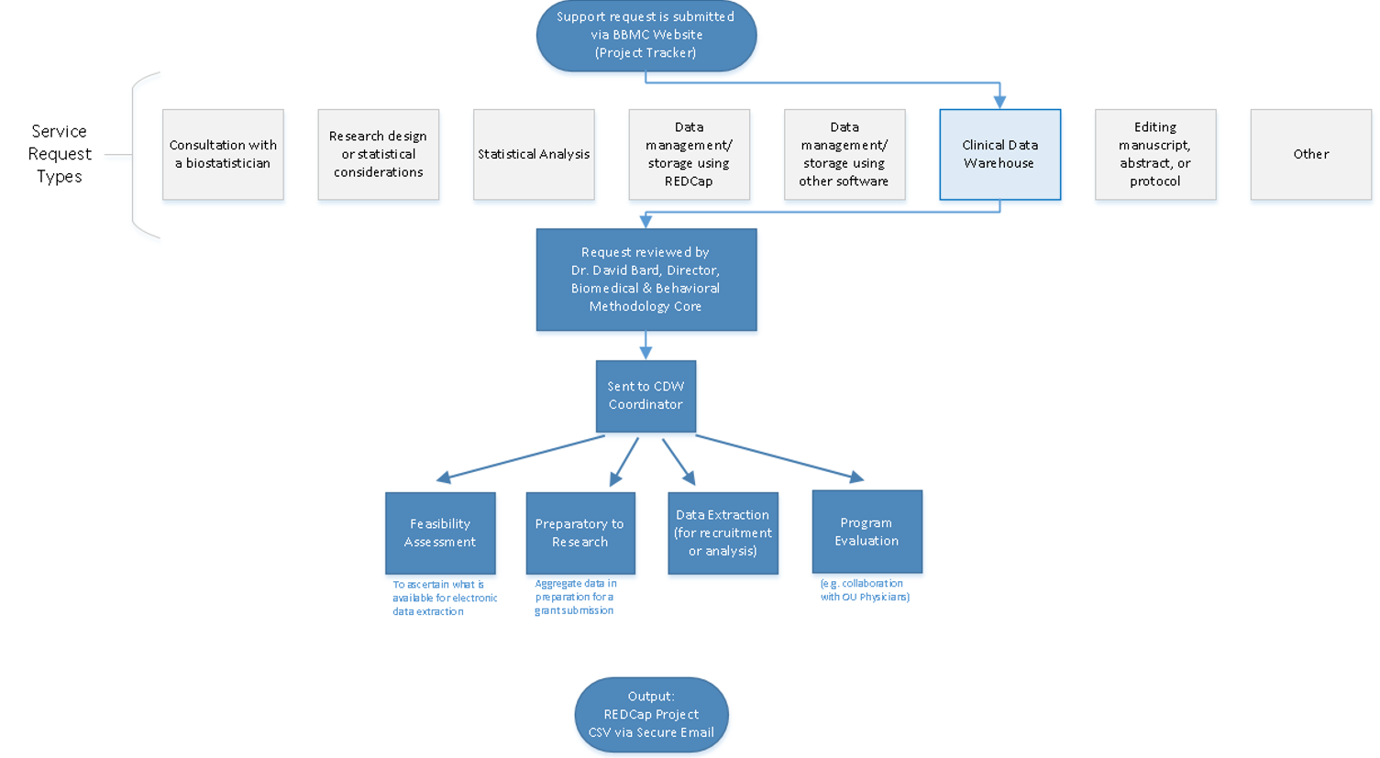
Commonly Requested CDW Support Services
Feasibility assessment in preparation for research (20% of projects; 10% of CDW staff time)
Static eligibility (70% of projects; 20% of CDW staff time)
Virtually all projects require identification of a patient pool
Rolling eligibility (30% of projects; 30% of CDW staff time)
Remember study team’s assessment of eligibility as well as the participant’s response
Daily automation requires stability & good logging; e.g., a 3 hour delay might mean zero subjects are enrolled
Clinical outcomes for retrospective investigations (50% of projects; 30% of CDW staff time)
Administrative outcomes for quality improvement (10% of projects; 2% of CDW staff time)
Program evaluation (20% of projects; 8% of CDW staff time)
Notes:
Here are the services we provide. This roughly reflects the needs of the campus, but it’s not one-to-one. For example, I’m sure there are still a lot of manual chart reviews to create eligibility lists. Also, there are several groups on campus, like BERD, that are great at analyzing the outcomes once the datasets is delivered in a suitable format.
As PIs decide how big of a bite to take, some come to us to get a feel for the counts of patients meeting the conditions of interest. These tasks typically not too heavy, so we can complete most within a day.
One-time eligibility is requested a lot, partly because we’ve built a little reputation around it. And virtually all projects need that patient pool defined. To create this pool our code doesn’t change much between active studies and retrospective studies. We’ve designed our pipeline to reuse a lot.
If it’s not a one-time enrollment, it’s typically then an ongoing recruitment. That takes more time because a lot of factors need to be incorporated to keep it efficient for humans to process. And even if it took zero seconds to develop, that daily automation inevitably requires some maintenance as those eligibility lists are deployed every morning. Although most mornings, the automation is smooth and it’s a simple check for a human to review everything passed.
Clinical outcomes is what I thought would soak up the majority of our time, but that’s been fairly manageable so far.
And occasionally we get administrative and program eval tasks that fit inside a larger research project.

Slide 10
IRB and Privacy Review Guidance
Requests that are preparatory to research must be submitted to the IRB/University Privacy Board for review and approval.
Program Evaluation, CQI, & Feasibility Assessments:
If PHI is NOT included, it is generally not considered human subjects research.
A determination of human subjects research (DHSR) may be submitted to the IRB.
Aggregate data may be provided without an IRB submission.
The following activities are NOT human subjects research:
Classroom evaluation activities when assessment involves regular classroom activities and the results of the evaluation process are intended to be used for the sole purpose of enhancing teaching practices of the instructor
Quality improvement activities designed to enhance functionality of a department or campus program provided that results are not intended to be shared outside of the University
Program evaluations
Public health practice surveillance activities
Notes:
In short, we work closely with the oversight boards to maintain compliance & improve efficiency. A new governance board is being created that’s co-chair by the informatics heads of the hospital and of the clinics. I’m excited that this will speed up parts of our process for those studies that don’t require an IRB.
[8 min cumulative]

Slide 11
POPS Study
Pharmacokinetics of Understudied Drugs Administered to Children per Standard of Care
darden-pharmaco-2
Notes:
For the middle part of my talk, I’d like to summarize the prototypical studies that span our spectrum. And start with a big one that has lots of features we reuse in many smaller projects. Consequently their turn around is faster and thoroughness/quality is higher.
This POPS study …

Slide 12
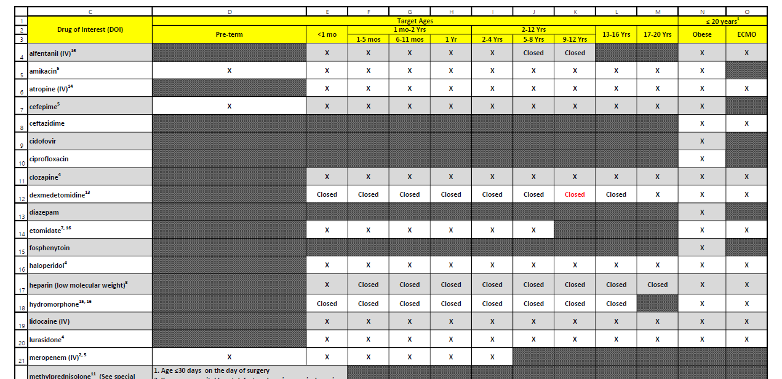
POPS Overview
Primary Aim: Evaluate PK of understudied drugs administered to children
Part of Oklahoma Pediatric Clinical Trial Network (OPCTN), a site for the NIH-funded ECHO IDeA States Pediatric Clinical Trials Network (ISPCTN)
Enrollment Criteria:
Child receiving understudied drug of interest (DOIs) per standard of care
meet age range or condition (pre-term, obese, ECMO) open for enrollment.
darden-pharmaco-2
Notes:
This multi-site project monitors kids prescribed with off label meds –with an important constraint. The researchers can’t perform any extra procedures on a patient. Some of these cells need spinal fluid, but the study can’t get it unless it’s already being collected. So it’s really important to get the info to the research nurses early in the morning to piggy back the collections. Information that is a day old is worthless, especially for the inpatients. The whole approach needs to be proactive and anticipatory, leveraging automation to deliver reports quickly.

Slide 13
Resource Efficiency: fewer patients, quicker review, less redundancy
Old System
New System
2019-01-12 Inpatient Extract
Finds patients who received a drug of interest
109 unique patients
Record review: ~15 min/pt
~1,635 minutes
2019-01-13 Inpatient Extract
112 unique patients @15 min/pt (forgets yesterday)
2019-01-12 Inpatient Screening Report
Finds patients who received a drug of interest and meet an age range or condition currently open for enrollment
31 unique patients
Record review: ~5 min/pt
~155 minutes
2019-01-13 Inpatient Screening Report
6 new patients @5 min/pt (remembers yesterday)
darden-pharmaco-2

Slide 14
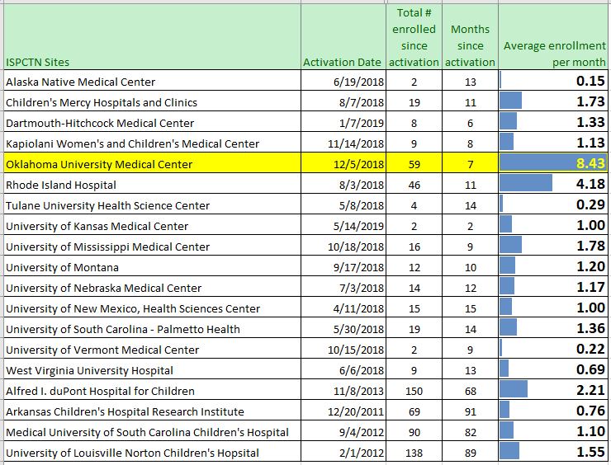
Enrollment Rate by Institution
darden-pharmaco-2
Notes:
Here’s a piece I’m proud of. It demonstrates that investing in the spiderweb’s breadth and the report’s ergonomics can translate into substantial gains.
Our pace in our first seven months was twice as large as the 2nd highest site. This is advantage of ours is independent from the brand of EMR. Many of these places have Epic.
~~Besides the pace, our total volume is 4th highest overall, even when considering locations that started years ago.~~

Slide 15
darden-pharmaco-2
Notes:
Here is the schematic of most elements in the daily pipeline. It
pulls from the inpatient EMR and outpatient EMR (several tables involved in each), then
identifies inclusion & exclusion criteria for each potential patient, then
determines if we’ve already approached the patient (and if they’ve consented or declined), and finally
sends output to REDCap and to an html report for the research staff to use.

Slide 16
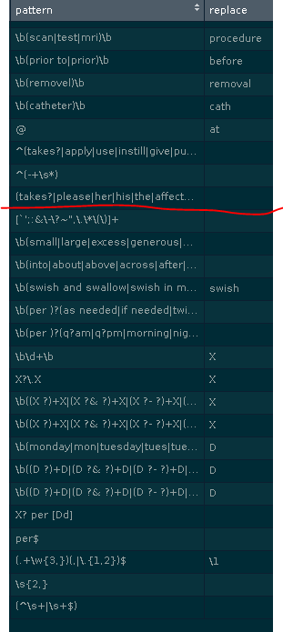
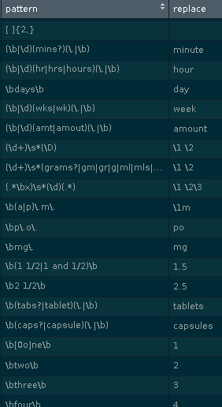
Collapsing/Standardizing Med Instructions
Use regular expressions to match free-text, and replaces with a ‘better’ value.
Correct misspellings
Remove junk
Standardize format (eg, space between `5mg`)
Standardize term (eg, `cap`, `caps`, &`capsule` to capsules`)
Remove info irrelevant to eligibility below the red line (eg, `1mg` and `2mg` becomes `X mg`)
Reduces 130k entries to 46k
darden-pharmaco-2

Slide 17
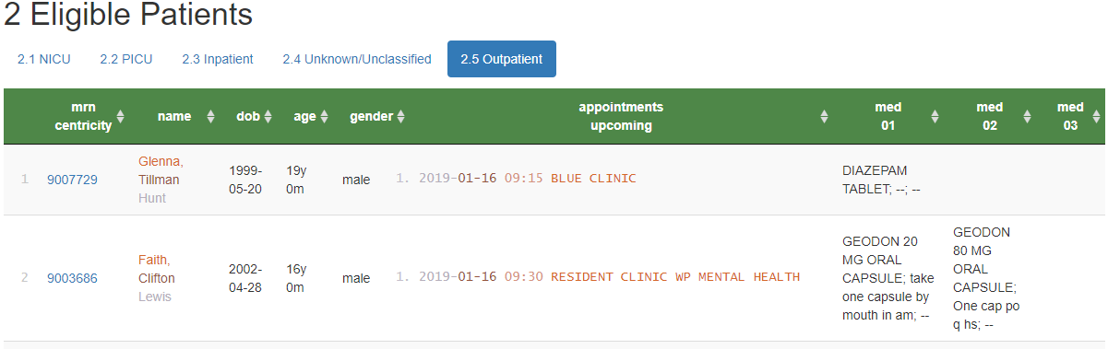
Screening Reports (for outpatients)
Shows upcoming appointments of potentially eligible patients
Location of care
Appt Date & time
Qualifying medication (e.g., Diazepam)
Qualifying condition (e.g., obese, 24 months old)
Similar inpatient process was developed
Eligible Patients for POPS
(Simulated patients)
darden-pharmaco-2

Slide 18
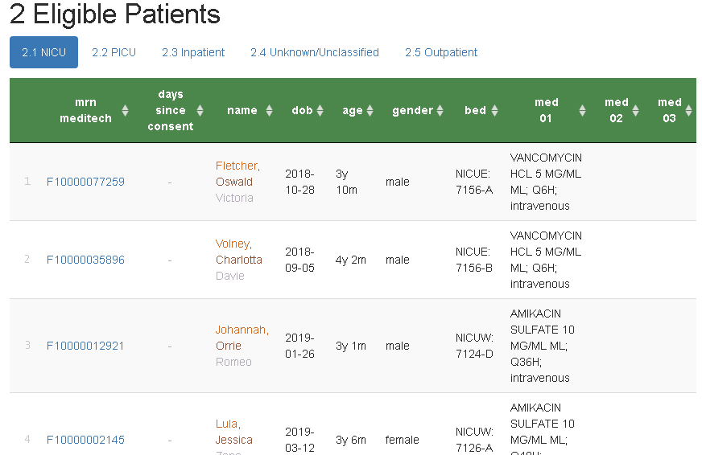
Screening Report (for inpatients)
Hyperlinks to REDCap
Consent stop watch
Filter, search, & sort
(Simulated patients)
darden-pharmaco-2

Slide 19
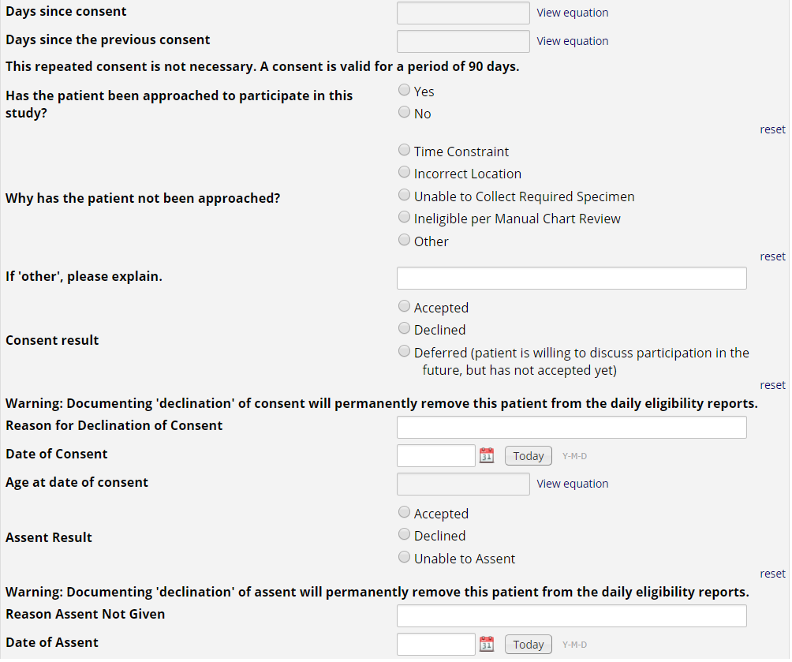
REDCap Project
Approached?
Consented?
Assented?
darden-pharmaco-2
Notes:
Research nurses use the MRN hyperlink on the eligibility report to document approached/consent/assent in REDCap.
If a patient or guardians ‘declines’ consent or assent, the patient is removed from future eligibility reports.
This also allows us to create summary stats for the investigators to monitor progress, address issues with resource allocation, etc.

Slide 20
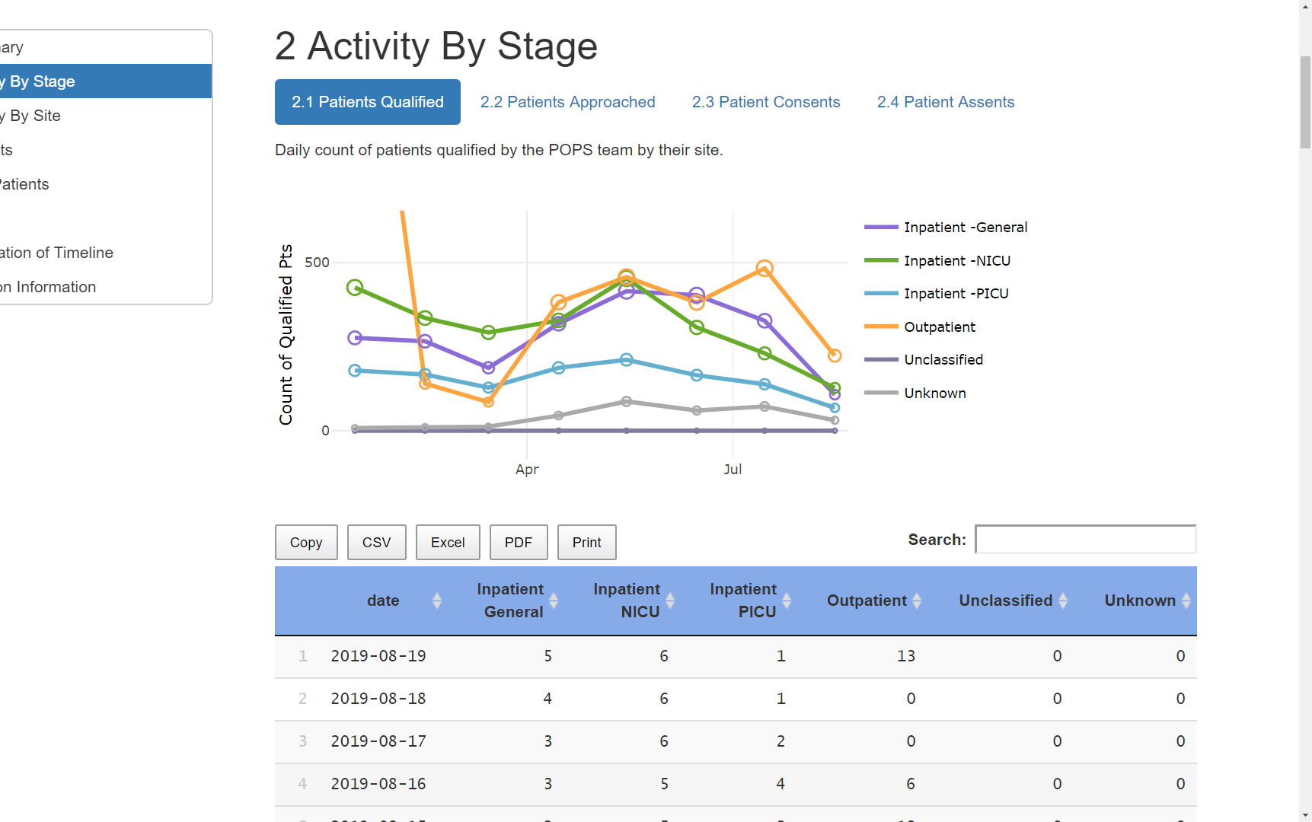
Progress Reports
See the forest.
3-way breakdowns of:
time
site
drug
age
gender
stage
qualified
approached
consented
assented
darden-pharmaco-2

Slide 21
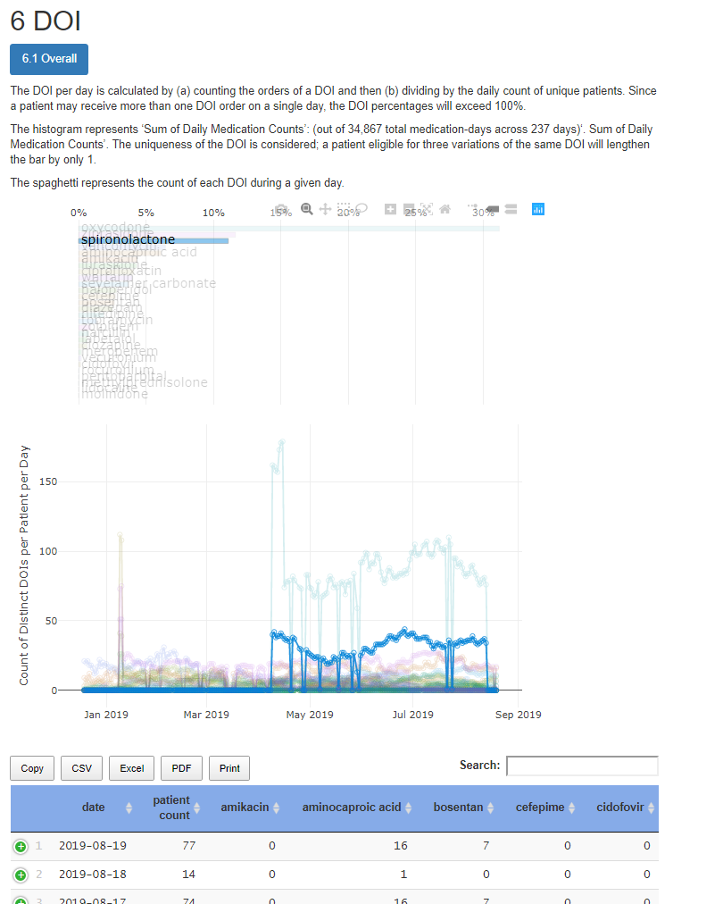
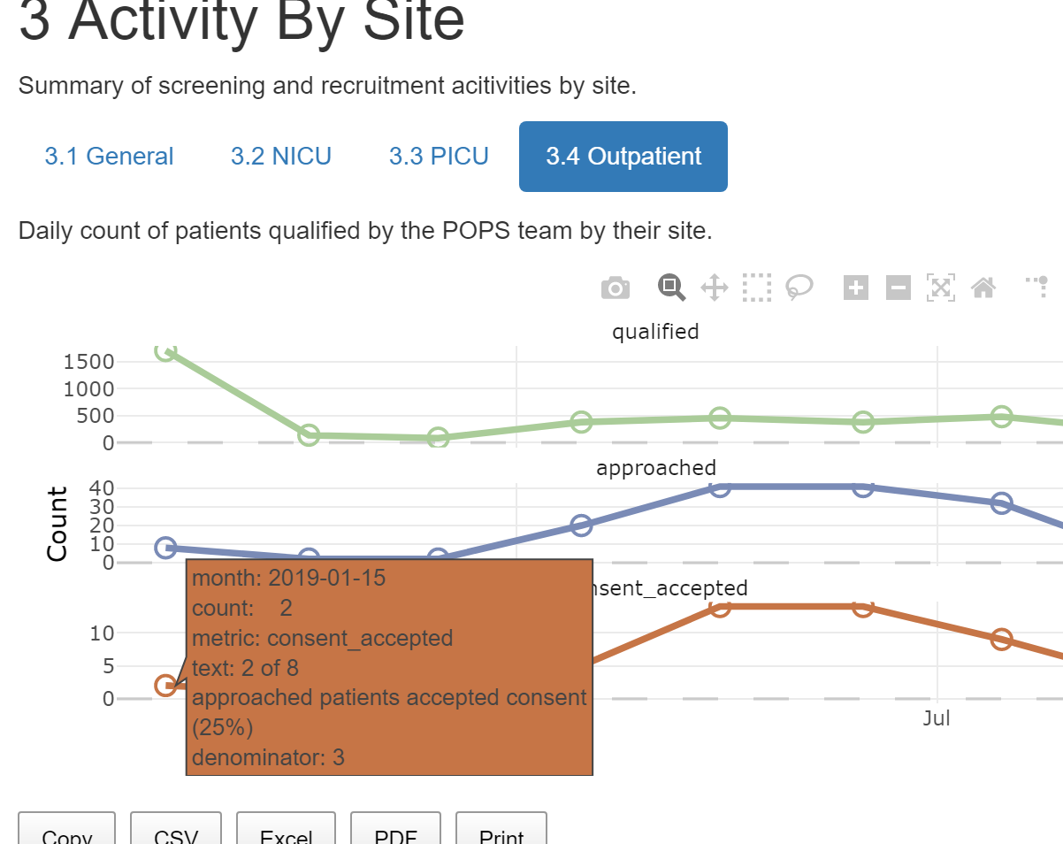
Progress Reports
darden-pharmaco-2
Notes:
[15 min cumulative]

Slide 22
CDW Strategy: don’t overbuild
Some studies don’t require a full reporting solution
Scenario 1: big study already has an established tracking pipeline
Scenario 2: small study has a tight focus; 2 part-time nurses can review the ~3 patients each morning
If only a CSV of daily patients is required, we can deliver within 2-10 man-hours.
This includes:
Pulling fresh info from inpatient & outpatient EMRs
Saving a CSV each morning to a file server
Logging of pipeline steps to a protected text files to facilitate quick diagnoses & fixes
Notes:
[

Slide 23
CDW Strategy: a good framework
Permits fewer SQL & R files per study
Permits re-use of metaphors & patterns across studies
Easier for us to develop & maintain
Easier for investigators in subsequent projects
Lessons from one project benefits subsequent projects

Slide 24
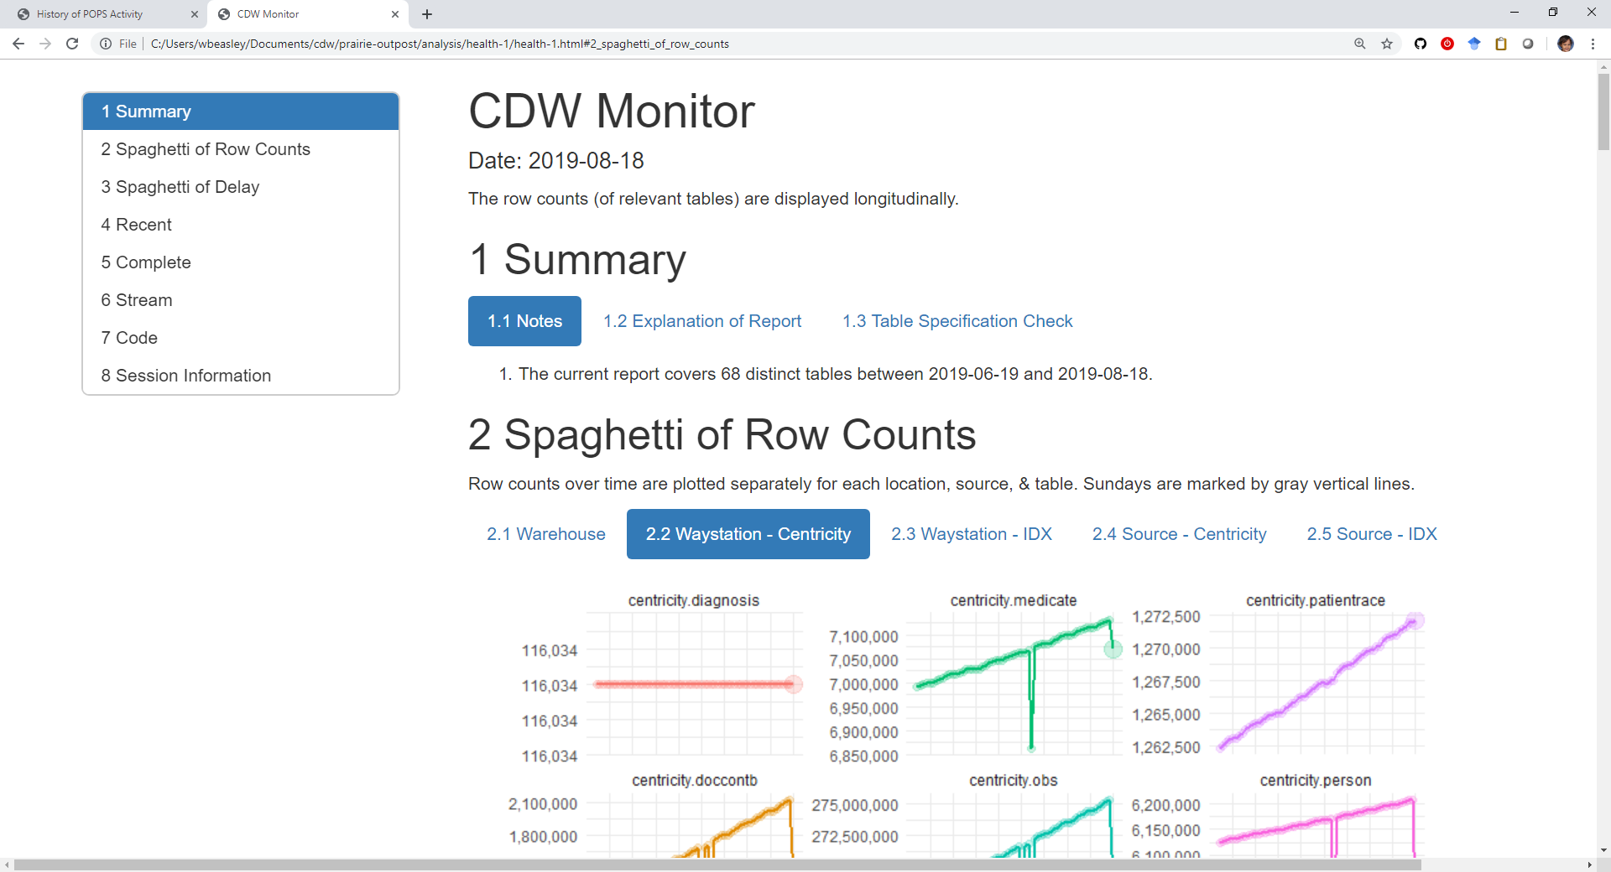

Slide 25
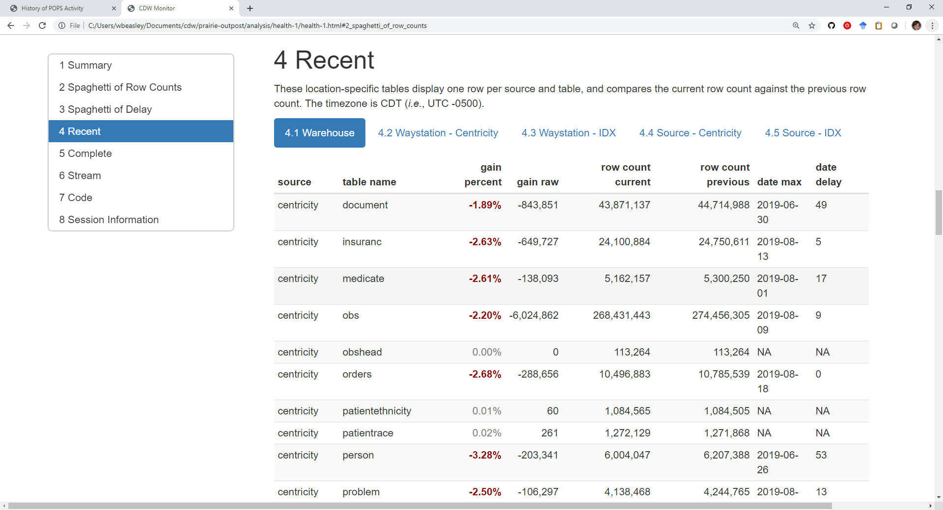

Slide 26
VDORA Study
Vitamin D Supplementation in Children With Obesity-Related Asthma
mehdi-vdora-1
Notes:
This second study is an example that’s essentially a subset of POPS.

Slide 27
Success Story of Rapid Deployment
An ECHO-funded study team was unsuccessfully recruiting subjects.
Manually previewing patient charts (3-4 hours to do properly)
Relying on MDs to confirm eligibility prior to appt
OSCTR suggested leveraging the CDW.
Daily pt list was being delivered within three days (and 10 man hours).
This would not be possible without the lessons & framework built for POPS
mehdi-vdora-1

Slide 28
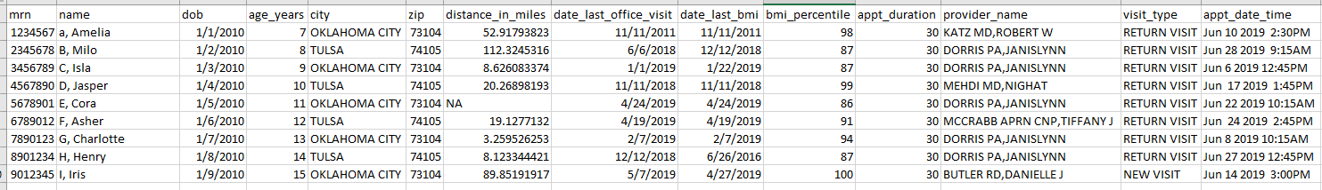
appt.csv
(Simulated patients)
mehdi-vdora-1

Slide 29
VDORA: Vitamin D Supplementation in Children With Obesity-Related Asthma
Objective: Determine PK of Vitamin D supplementation in children who have asthma and are overweight or obese.
Part of the Oklahoma Pediatric Clinical Trial Network (OPCTN), a site for the NIH-funded ECHO IDeA States Pediatric Clinical Trials Network (ISPCTN).
Enrollment Criteria:
child ages 6 – 17; diagnosis of asthma; documentation of obesity; meet additional inclusion criteria such as ‘an ability to swallow pills’.
Precalculated “distance from residence to clinic” is displayed
Subjects have to comply with frequent trips to the clinic
mehdi-vdora-1
Notes:
Sometimes it isn’t a question of efficiency, but of existence.
In the 5 months before our involvement, they had recruited zero patients.
In the 3 months since our involvement, they have consented six patients.

Slide 30
Resource Efficiency: fewer patients, quicker review, less redundancy
Manual Screening Process
Obtain a list of appointments scheduled the following week
Review each medical record using the inclusion/exclusion checklist:
Other criteria
Age
Diagnosis of asthma
Documentation of obesity
Email providers for review/input
Volume: 130 charts
Time: 240 minutes
Automated Screening Process
Review select medical records for:
Other criteria
Email providers for review/input
Volume: 24 charts (screened out 106)
Time: 45 minutes
mehdi-vdora-1

Slide 31
Akande-medically-complex-1
Access to Primary Care and its Impact on Hospital and ICU Admission for Children with Medical Complexity
akande-medically-complex-1
Notes:
This project uses the CDW to detect the diagnostic complexity of the patient without manually reviewing the charts.
This is an example of a retrospective review that ultimately influenced a clinic’s internal organization and its goals. The project started out as a research study, but became much bigger. The new program will be implemented as clinical services. A group of physicians are actively working on implementing a complex care clinic for outpatients. “Complex care”, meaning their diagnoses and treatments involve multiple body systems.
{Manzilat Akande in Pediatrics}

Slide 32
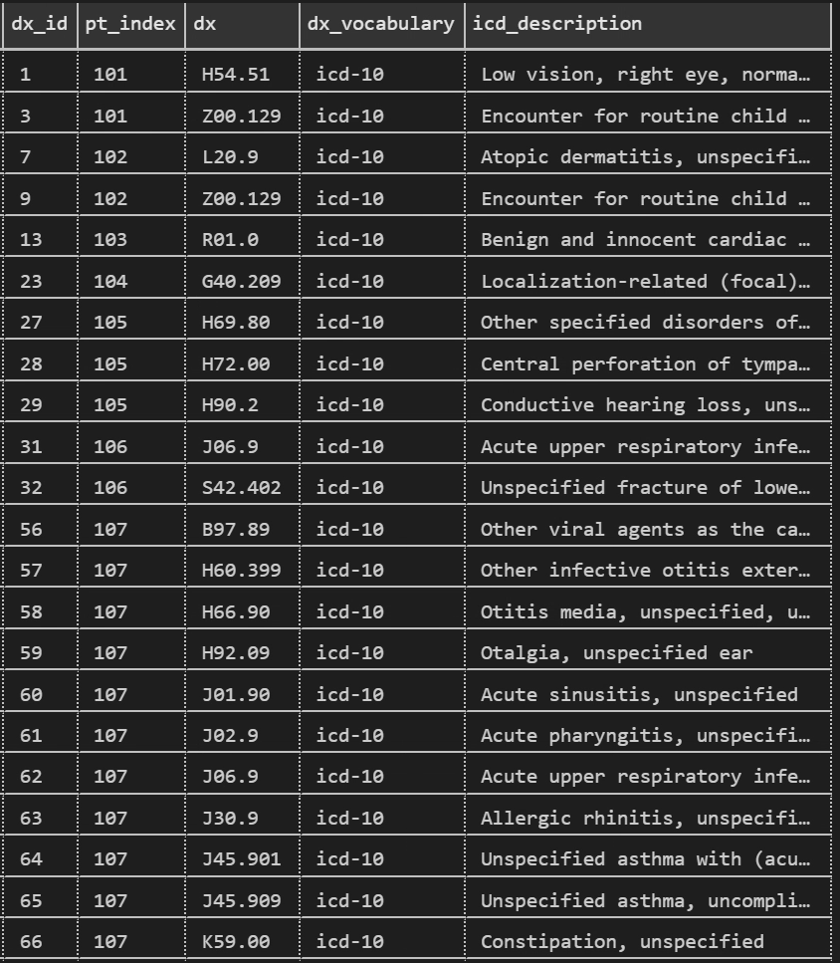
Complex and/or Chronic
Review combinations of dx seen with a patient to determine
Complex? (ie, multiple systems)
Chronic? (eg, long- vs short-term)
Use classification systems to simplify the 100k distinct dx codes
Profile of patients inform how clinics can be structured
Complex patients can be identified in the EMR (but this is outside the CDW mission)
akande-medically-complex-1
Notes:
Here is a glimpse of the dx codes for seven patients. Instead of selecting a subsample of clinic patients, then reviewing their charts, then manually and subjectively classifying them into buckets ...we leveraged existing coding systems and classification schemes.
First, a specific dx (3rd column) is assigned to body systems (eg, cardio and/or gi) and whether it’s a chronic disease or not. Then a second-layer scheme determines if the patient is “complex” or not and “chronic” or not.
This approach
reduces the manpower required to manually review and classify patients
reduces the subjective differences between human coders, and
reduces the statistical variability from inferring the sample to the future population

Slide 33
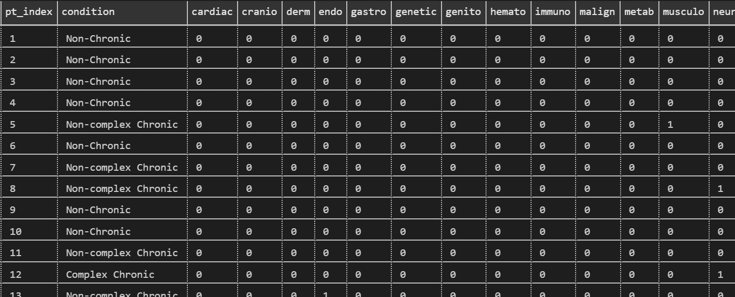
akande-medically-complex-1
Notes:
The dxs are collapsed across a patient in this dataset. It’s one row per patient.
A manual approach would take weeks or months to process several hundred patients. The programmatic approach completes 100k patients in a few minutes. Because it handles much larger samples, you can pursue much smaller signals and complicated hypotheses.
And we can rerun this daily if necessary with minimal additional cost & time for each run.

Slide 34
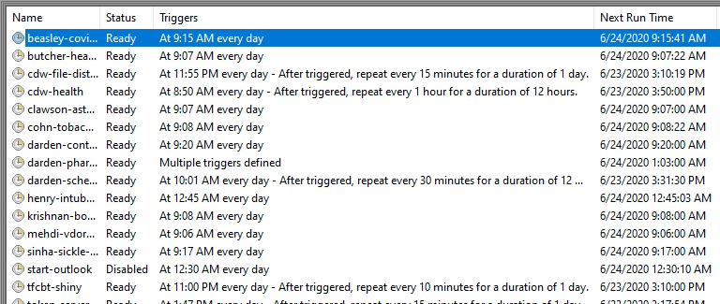
Automated Scripts
project-specific tasks that run repeatedly (Aside from the formal CDW pipeline that occurs on the database server).
The output is directed to locations accessible only to the study team
Notes:
There’s a whole list of project-specific scripts that run on our secondary server. The output typically goes to REDCap or a secured file server.

Slide 35
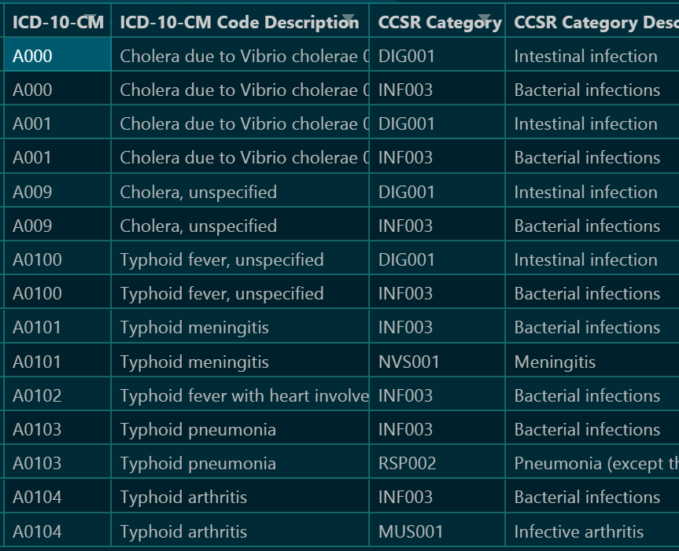
A variety of categorization systems are available
In theory, most concepts in an EMR can be categorized.
dxs are the cleanest
procedures & meds are feasible
pt histories are tricky
labs are the worst
10+ dx categorization schemes are published. Choose the one(s) best suited for your population and hypothesis
akande-medically-complex-1

Slide 36
Tung-ibd-1
Tissue Eosinophil Count in IBD patients
tung-ibd-1
Notes:
This project pulls from sources that most researchers have never accessed, such as docdata, docimages, and ‘external references’. …in addition to the usual things like obs and dx.
So much patient data exists in free-text notes, but it’s almost never used. This includes text that humans type, but also includes all the labs that are dumped there without structure. Sometimes the EMR will parse the labs and translate them to a structured and research-friendly format; but many times the labs aren’t correctly identified, categorized, or parsed. When that happens, we resort to digging out the lab info from the notes.
{PI: Jeanne Tung; Fellow: Zahra Nouri; pediatrics}

Slide 37
Steps to Leverage EMR “documents”
CDW-level tasks
(Notes are stored as multiple rows --2k characters per “document”)
Concatenate the 2-4,000 rows per document
Strip the RTF. (RTF is a markup language that specifies cosmetics like font size and color.)
Include a search index (similar to a book index) that makes searches & parsing more efficient
Project-specific tasks
Identify keywords that might indicate the document contains a relevant lab.
Extract the stem and result
eg, “normal fecal flora (moderate growth)”
eg, “negative for salmonella, shigella, and campylobacter”
tung-ibd-1

Slide 38
National Registry Example: COVID-19 CDW Registry Based on OMOP
covid-registry

Slide 39
National Registry
Institutions from 11 states combine covid data from their EMRs
There’s a national movement for investigations to be informed by multiple sites/institutions. Every research study and institution collects their data differently.
A CDM (common data model) is a standardized convention to store & describe data. Institutions extract and transform their EMR data
covid-registry
Notes:
if you're hunting big funding, many people believe you'll need to include multiple sites/states. For example Cf registry, sickle cell registry

Slide 40
Immunization Project
immunization-transition

Slide 41
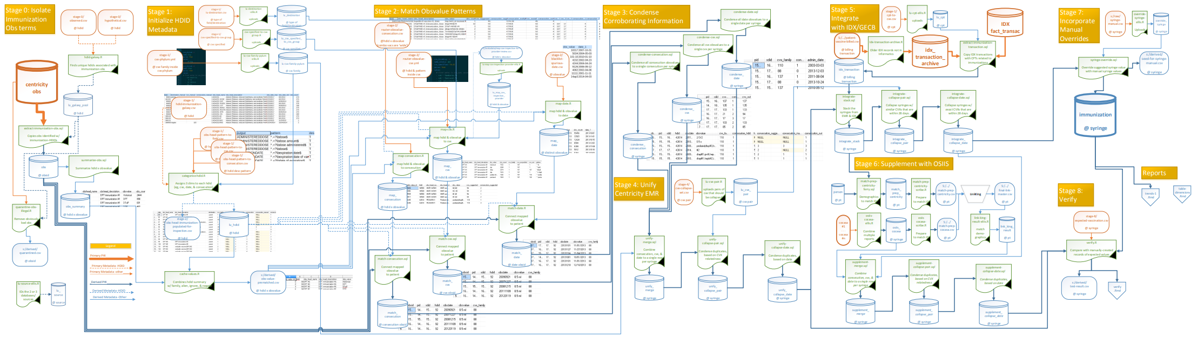
The goal of this project is to reorganize roughly 1 million vaccinations currently recorded in the GE Centricity EMR OBS table so those records may be transitioned to the new Immunization table.
Flow Diagram
immunization-transition

Slide 42

Stage 1: Categorize HDID/Obs
Stage 0: Isolate immunization hdids/obs terms
ObsHead Table
GE Migration Tool
OUP List
Immunization Obs Used
Stage 3:
Condense to one row per administration
Stage 4: Unify
DPT Shot #2
Admin Date
CVX
DPT Shot
CVX Code
Vaccine Type
Dose
Admin Date
Route
Stage 5: Incorporate
Billing
CVX “Family”
Stage 6: Incorporate
Health Dept
Field
Consecution /Sequence
DPT Shot
Admin Date
Expiration Date
Admin Date
Stage 7: Incorporate
manual overrides
Stage 2: Categorize value within
hdid/obs
Stage 8: Verify against expectations
immunization-transition

Slide 43
Immunization Scope
1,000,000 syringes
~100 vaccine types
10+ years
70+ clinics
immunization-transition
Notes:
The last two bullets produce the real difficulty. There is so much heterogeneity over times, places, and staff.

Slide 44
Brief Summary of CDW Value

Slide 45
Brief Summary of CDW Value
POPS: dynamic recruitment
OxyContin: electronic sorting and merging/patient matching
ADHD studies: Apply standard clinical vocabulary to support interoperability to help information exchange; isolated retrieval of text documents for mining
Diabetes Management/Transition of Care: Sharing of data across various sources improves quality of care and efficiency; maximizes utility of data
Immunization: Harmonization of records for quality reporting and improved accuracy of record history

Slide 46
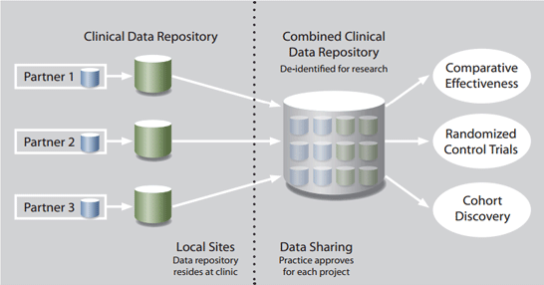
Where Other Universities are Headed
University of Washington:
Data Quest (https://dataquest.iths.org/)
Leaf- Integrates of Regulatory Oversight with Data Accession
De-identified prep to research
PHI access
TriNetX
Attract Industry-Sponsored Trials
Peer-institution Collaborations
University of Michigan
EMERSE (Electronic Medical Records Search Engine; http://project-emerse.org/)
Google for your free text EMR documents and notes
Similar to natural language processing (NLP)
Notes:
Also mention GIS capabilities and surveillance

Slide 47

LEAF
About LEAF
Self-service web application for querying and extracting clinical data
Flexible biomedical concept system to define hierarchical items and ontologies
Drag & drop user interface
Designed to seamlessly integrate with existing enterprise user authentication systems and clinical databases
Produces results which are identifiable (with IRB approval) or de-identified
Potential Uses
Cohort discovery: determine if enough patients meet a given set of conditions which match recruitment criteria
Statistics: quickly pull numbers, “How many patients were seen last month?”
Chart Abstraction: Generate a dataset for research or quality improvement purposes
https://www.iths.org/

Slide 48
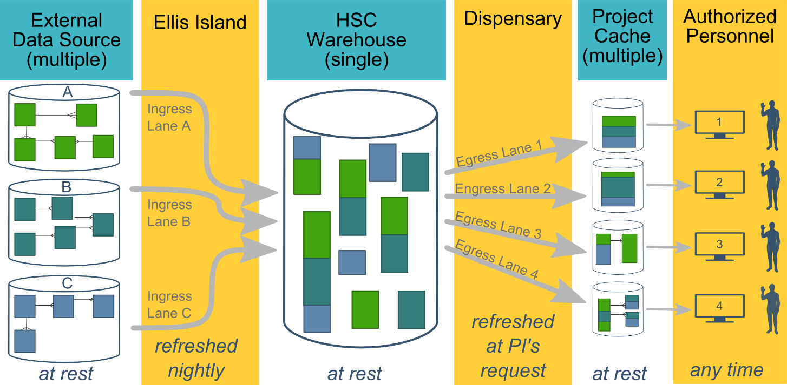
Current Developments: Common Campus-wide Warehouse
A tighter collaboration with
IT
BBMC
OU Physicians
Hospital
Notes:
We’re working with two informatics groups on camps to consolidate a lot of
It will be hosted and maintained by a new IT group, directed by vet of the OU EMR. They’re charged with building a warehouse for the whole campus, and they’ll likely take over the databases and pipeline code in the first three columns of our diagram. They’ll provide a project-agnostic warehouse to us, to OU Physicians, and to the hospital. The three groups will still develop our own downstream data lakes to support our specialized investigations. Some of our derived products and stable pipeline will provide a jump, and they have things we could benefit from too.

Slide 49
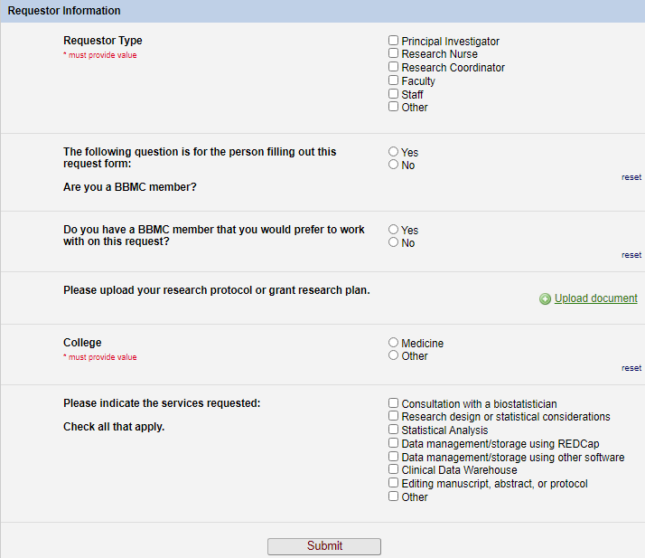
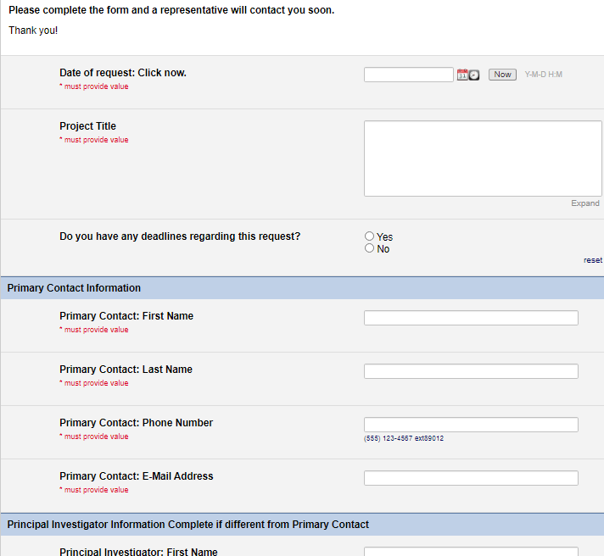
Starting a CDW Project
Submit a request at https://ouhsc.edu/bbmc/, then click “Request Support”
This helps us prep for the initial meeting w/ you
This box routes it to the CDW team

Slide 50
Thank you
Will Beasley, PhD
Ashley Thumann, MHA
Wale Oluborode, MD, MPH
David Bard, PhD
University of Oklahoma HSC
Biomedical & Behavioral Methodology Core (BBMC)
Award Numbers: UG1OD024950 U54GM104938

Slide 51
Extra Slides

Slide 52
OK HV-CoIIN
Oklahoma Home Visiting Collaborative Improvement and Innovation Network

Slide 53
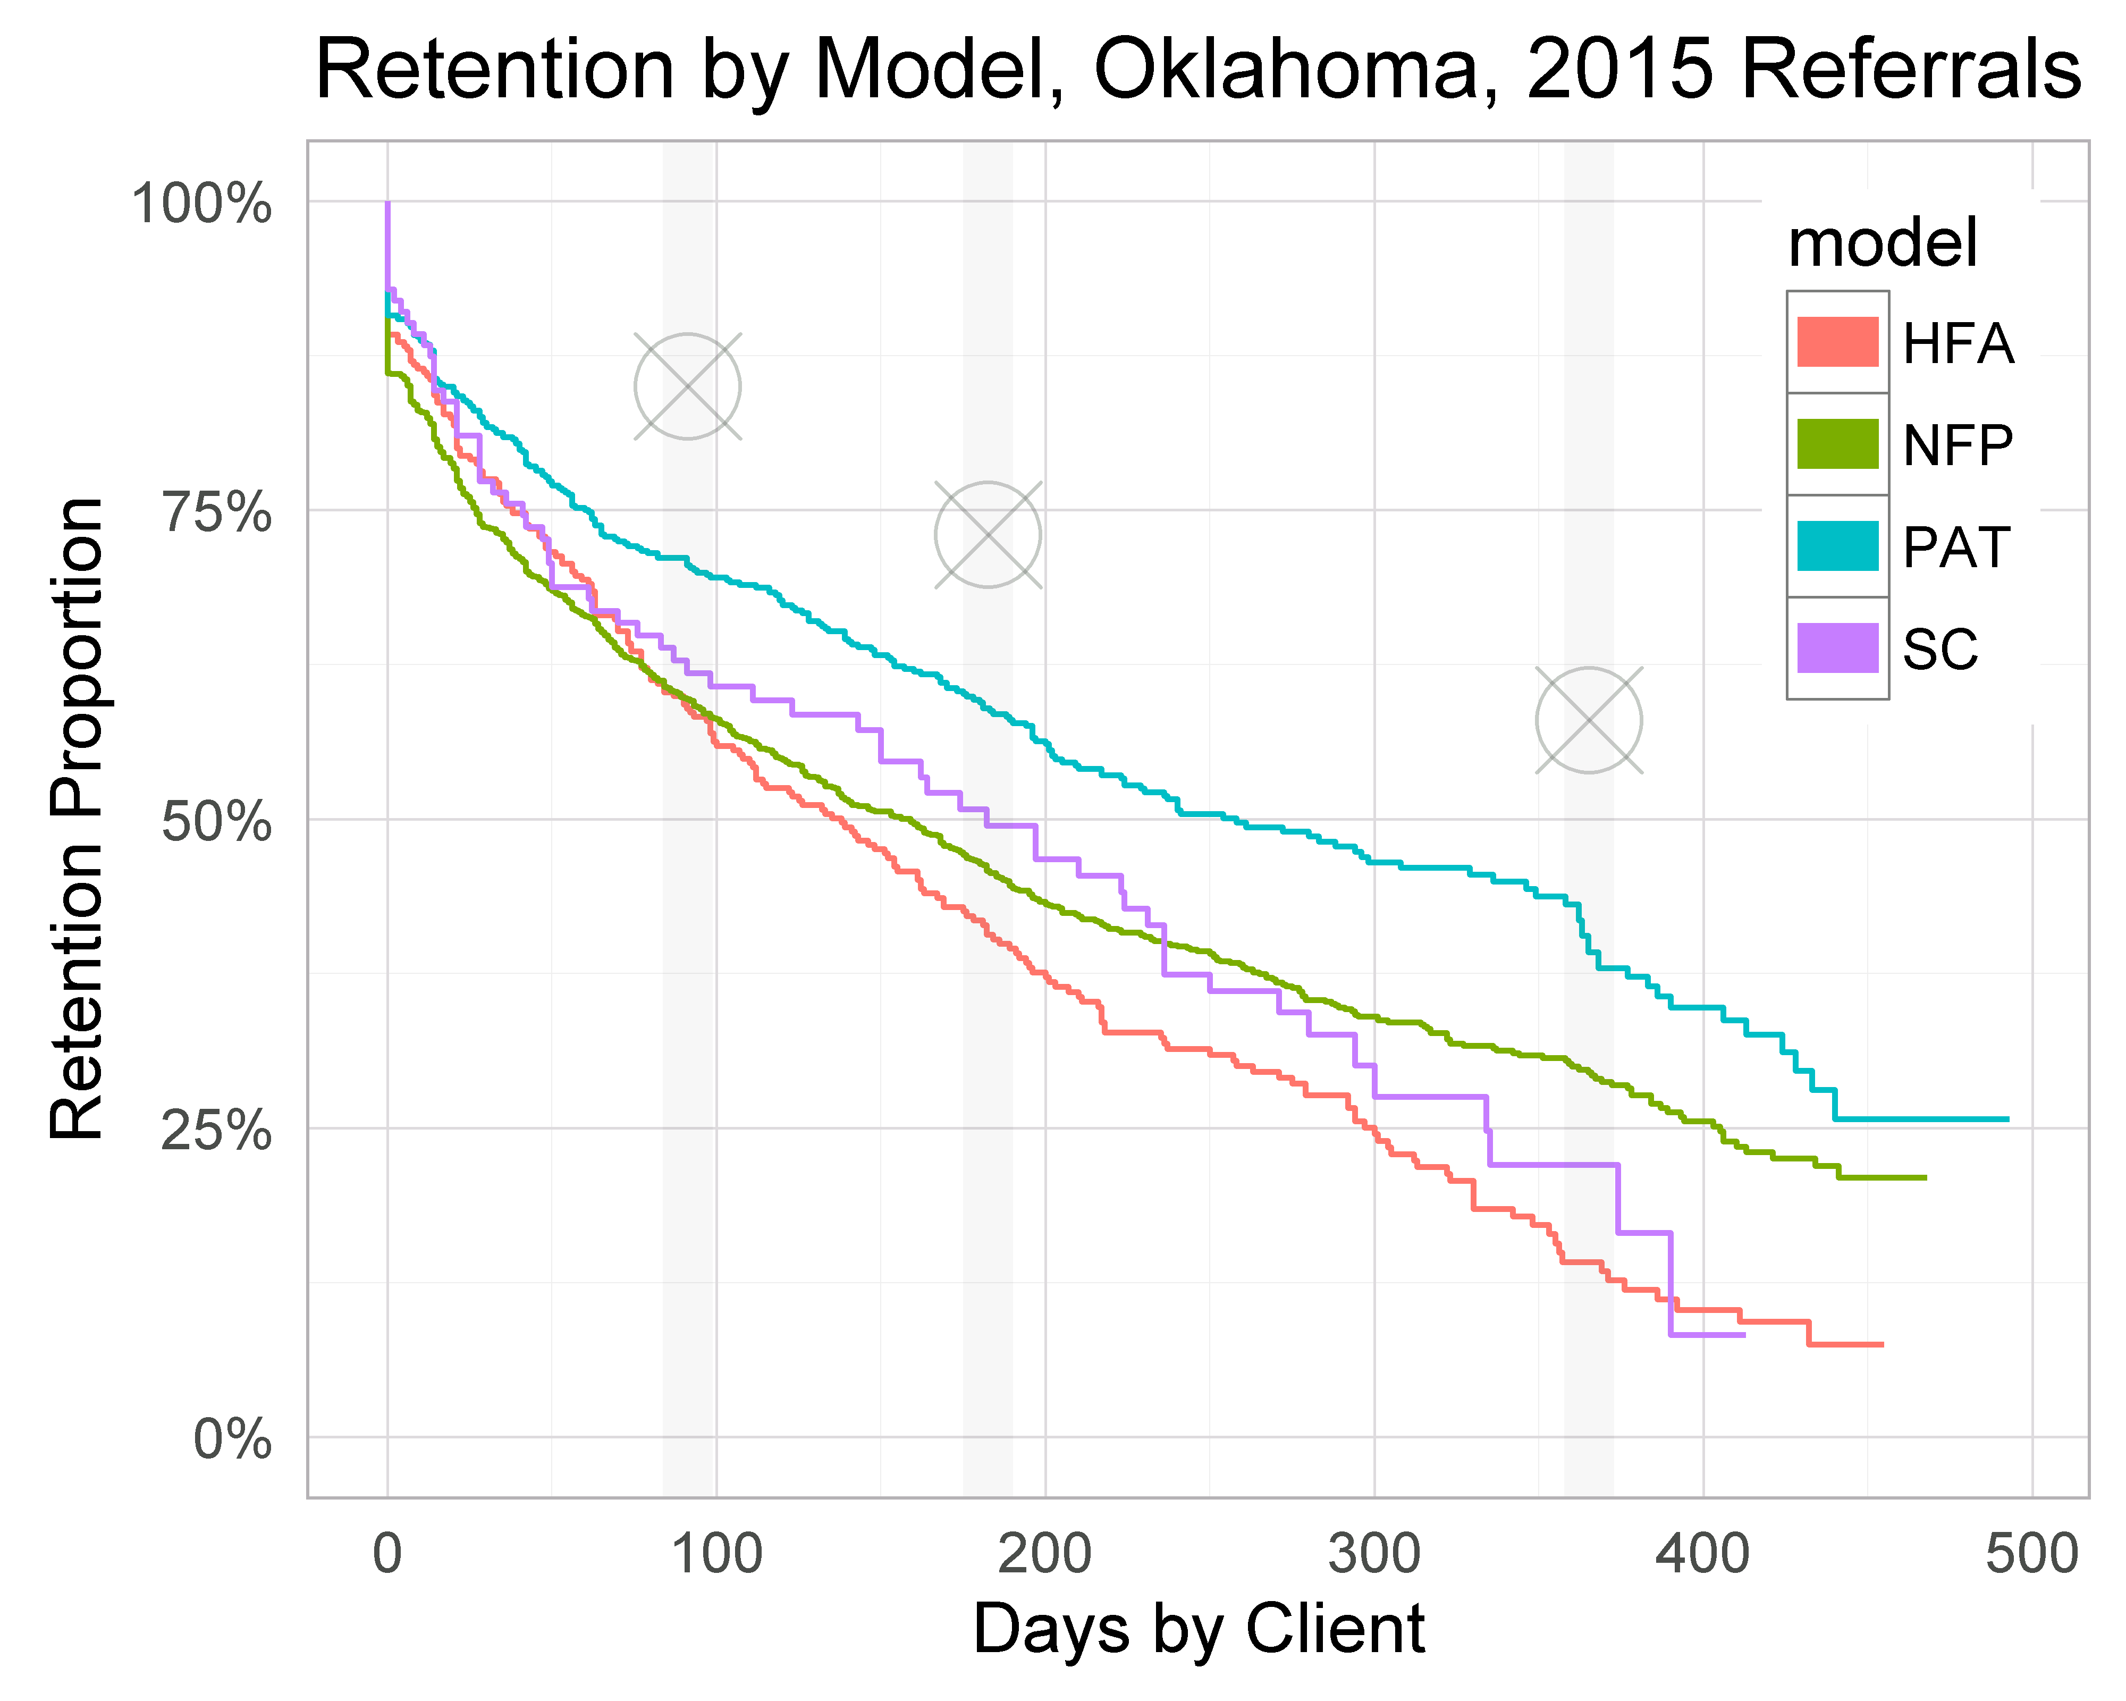

Slide 54
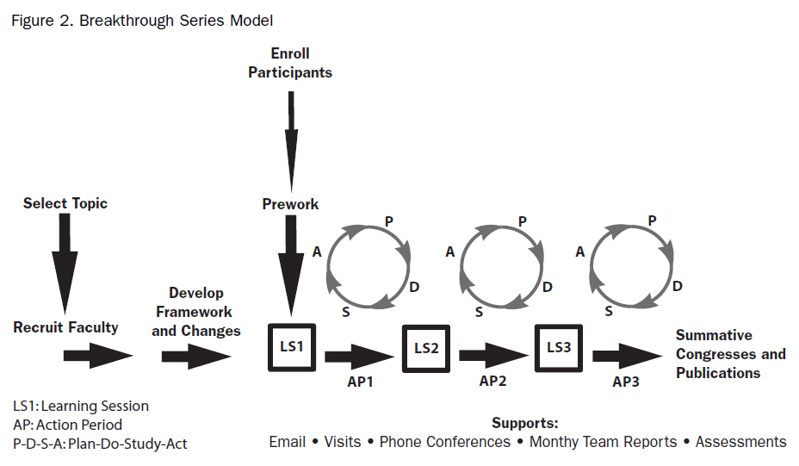
The IHI Breakthrough Series as the HV CoIIN Framework
Notes:
3
3
3

Slide 55
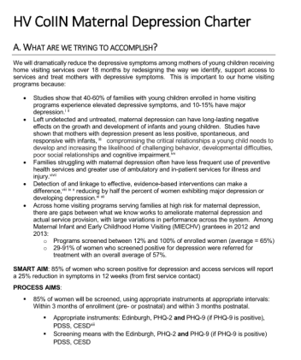
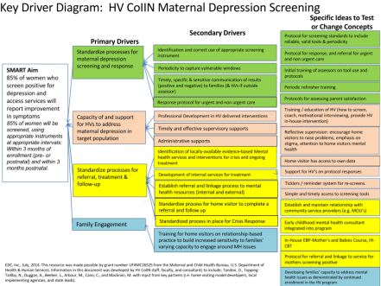
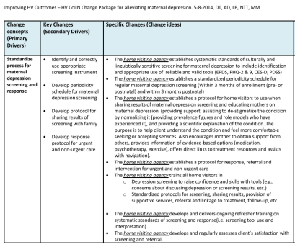
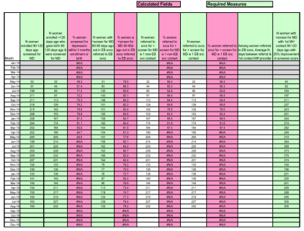
Developed a HV CoIIN “Playbook” for each topic
Charters
Key Driver Diagrams
Change Packages
Measurement
System
Key Word
Key Word
Key Word
Key Word
Helping Teams with the “Why, What and the How”

Slide 56
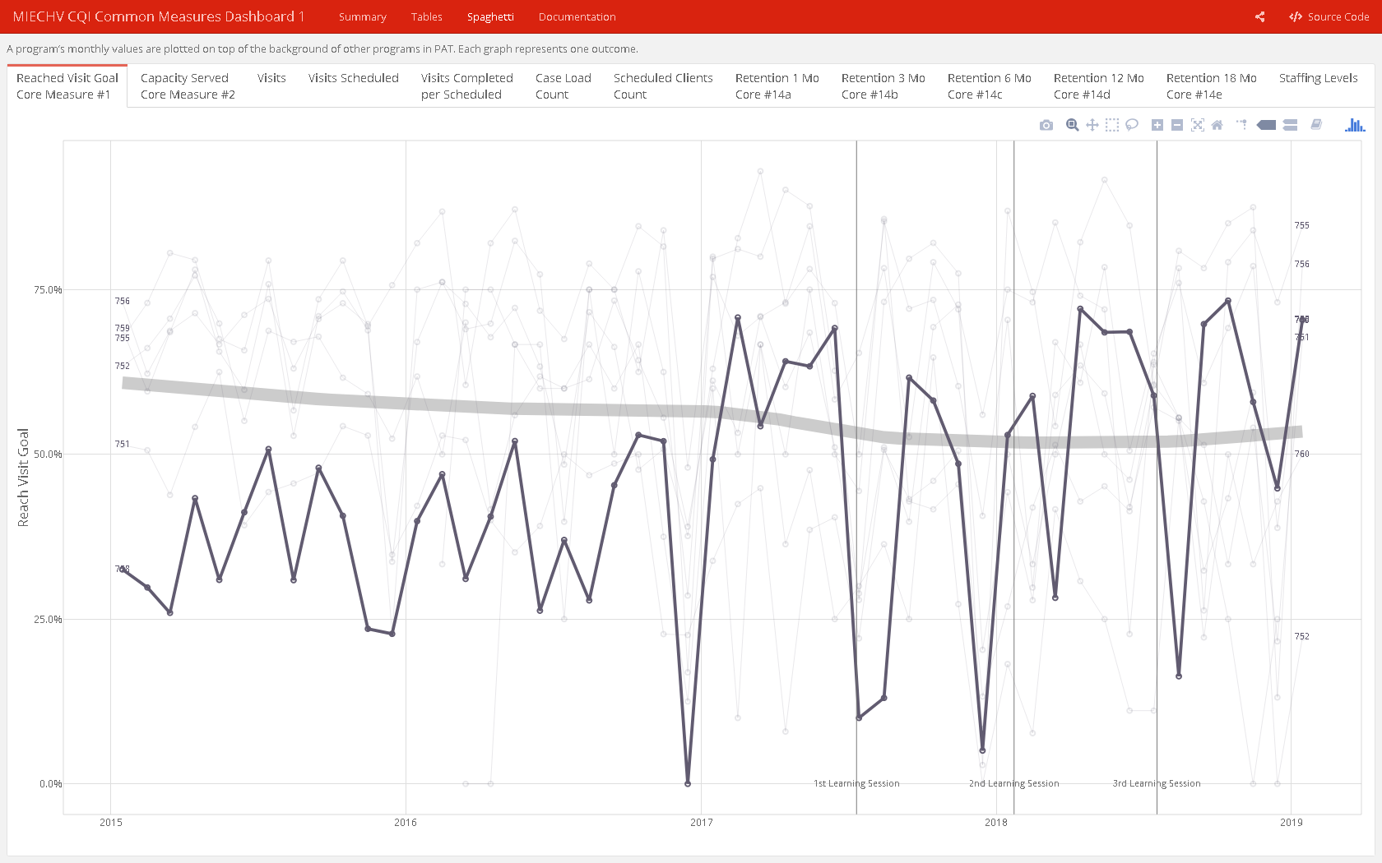
Dashboards
Two versions of a user-friendly dashboard were developed and administered weekly by team of analysts
Common measures
Individual

Slide 57
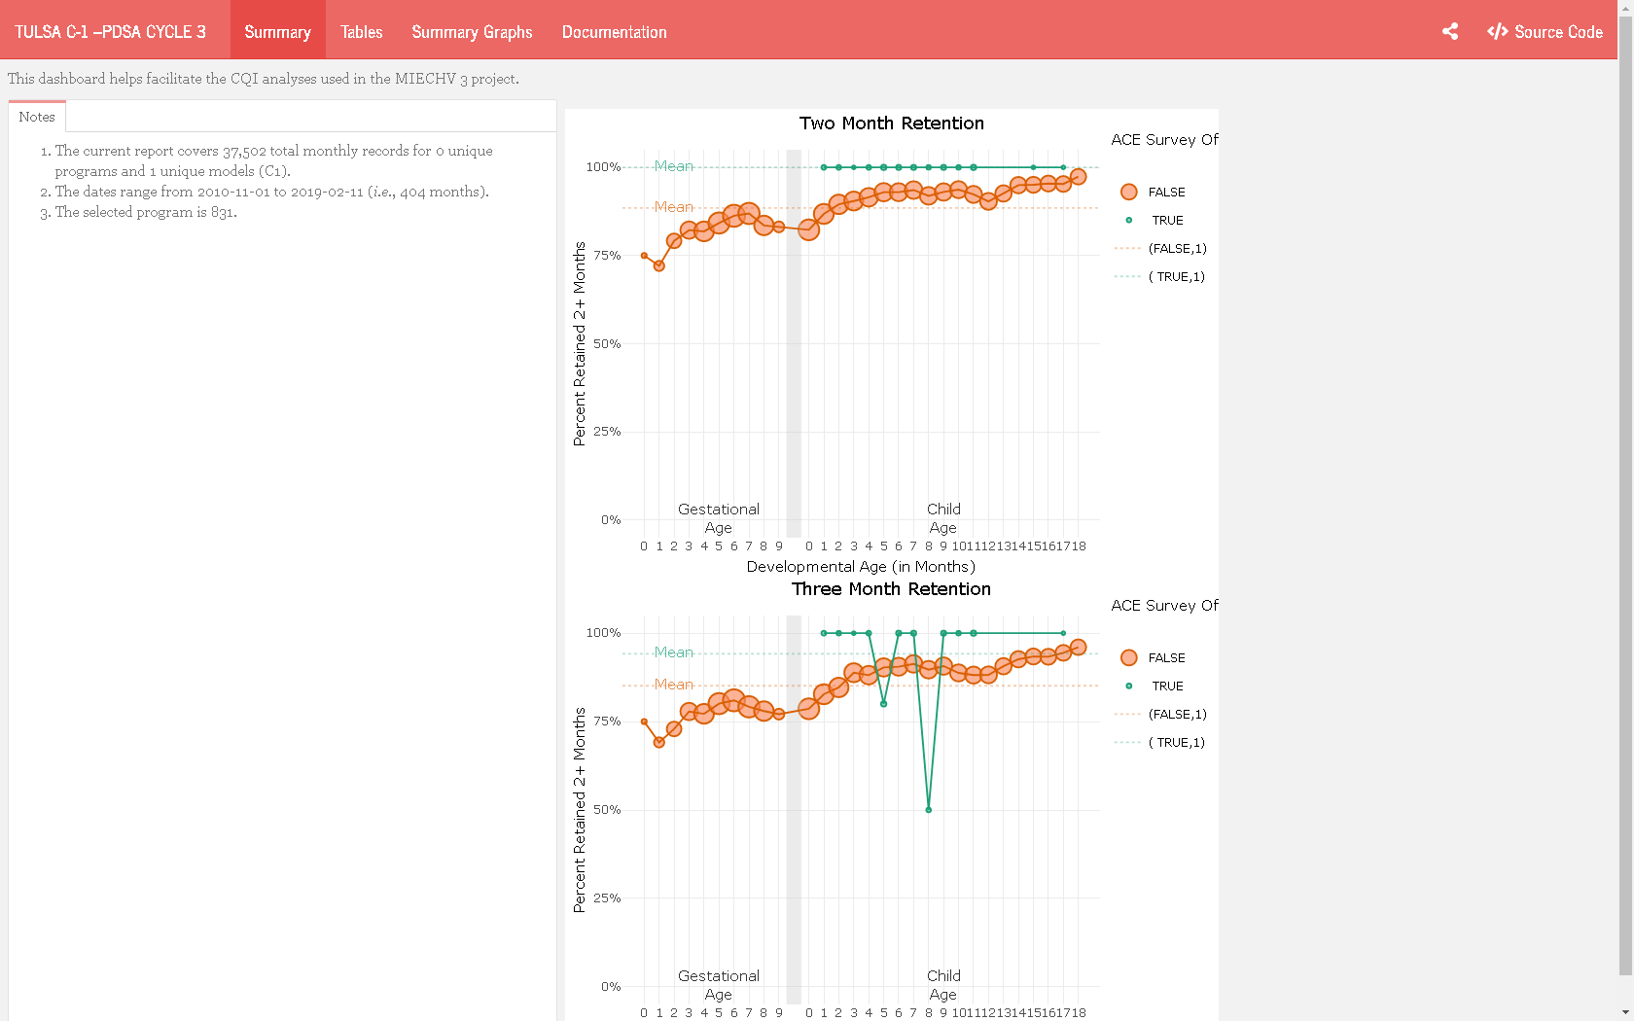
Dashboards
Two versions of a user-friendly dashboard were developed and administered weekly by team of analysts
Common measures
Individual

Slide 58
Future Applications: Clinical Decision Support
Notes:
Reference immunization project. Once our work is complete, the restructured data will be incorporated into clinical decision support within the ambulatory EMR system.

Slide 59
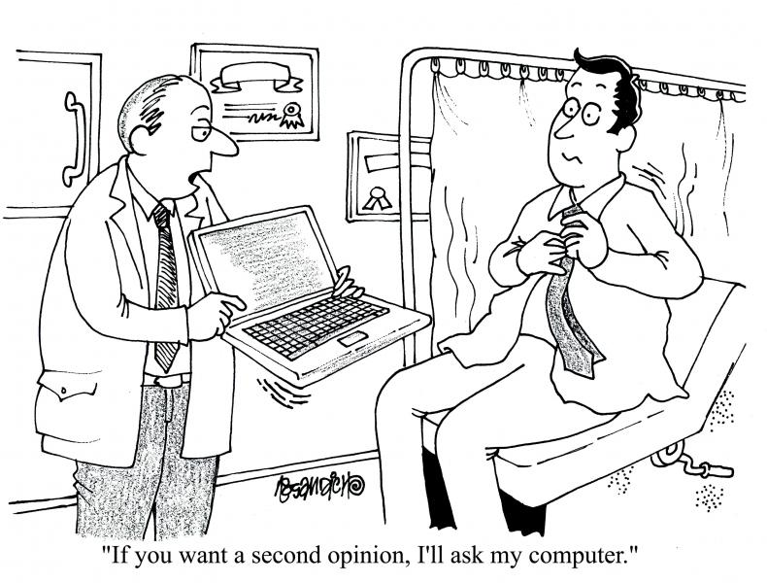
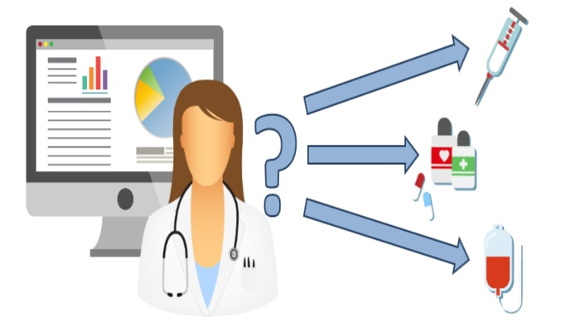
Notes:
Clinical Decision Support- better treatment recommendations, diagnostics, & decisions

Slide 60
PROSpect Study
PRone and OScillation PEdiatric Clinical Trial

Slide 61
PROSpect: PRone and OScillation PEdiatric Clinical Trial
Two-by-two factorial, response-adaptive multi-center randomized clinical trial.
Primary Aim: To provide evidence to support best ventilation practices in critically ill children with severe PARDS defined per PALICC guidelines.
Enrollment Criteria:
Pediatric patients >= 2 weeks of age and <18 years of age
Intubated and mechanically ventilated
Severe PARDS for <48 hours per PALICC guidelines.
henry-intubate-1

Slide 62
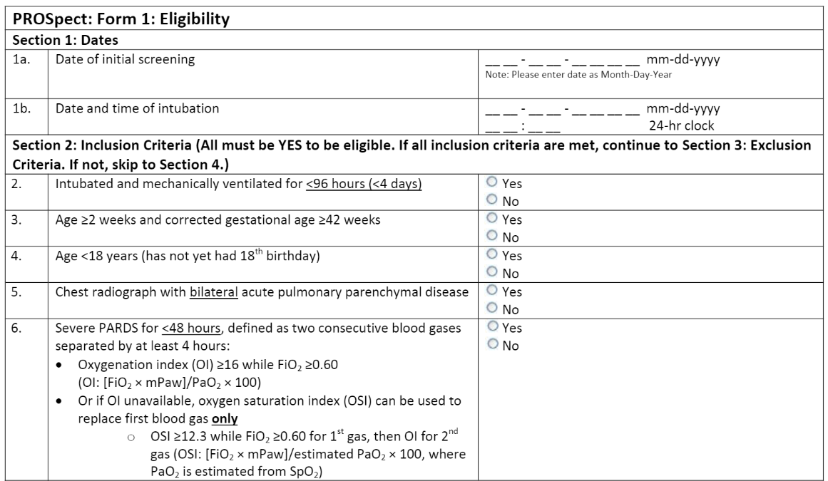
PROSpect: PRone and OScillation PEdiatric Clinical Trial
Exclusion criteria: previous enrollment in PROSpect, perinatal related lung disease, congenital diaphragmatic hernia or congenital/acquired diaphragm paralysis, respiratory failure explained by cardiac failure or fluid overload, cyanotic heart disease, cardiomyopathy, primary pulmonary hypertension, intubated for status asthmaticus, obstructive airway disease, active air leak, bronchiolitis obliterans, post hematopoietic stem cell transplant, post lung transplant, home ventilator or home oxygen dependent…

Slide 63
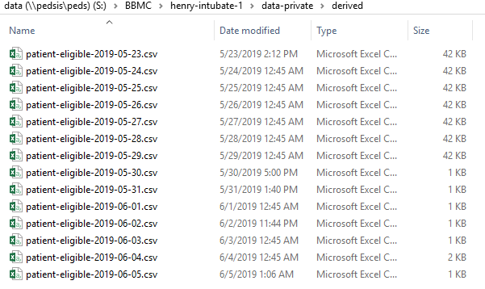
PROSpect: PRone and OScillation PEdiatric Clinical Trial

Slide 64
A Nationally Representative Drug Utilization Study of OxyContin in Children Age 17 Years and Younger

Slide 65
A Nationally Representative Drug Utilization Study of OxyContin in Children Age 17 Years and Younger
Multicenter retrospective, observational cohort study
Primary Aim: Conduct a nationally representative drug utilization study of sufficient detail to characterize OxyContin use in children.
Enrollment Criteria:
Age < 18 years at the time of OxyContin prescription
1+ dose of OxyContin as in/outpatient between 1-1-2011 & 12-31-2017

Slide 66
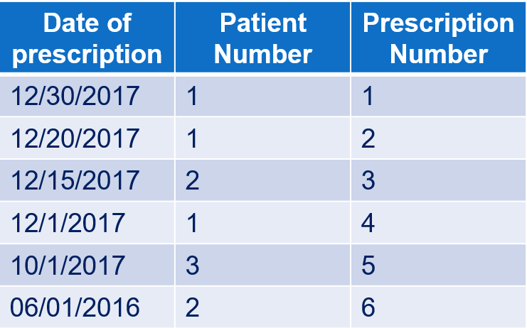
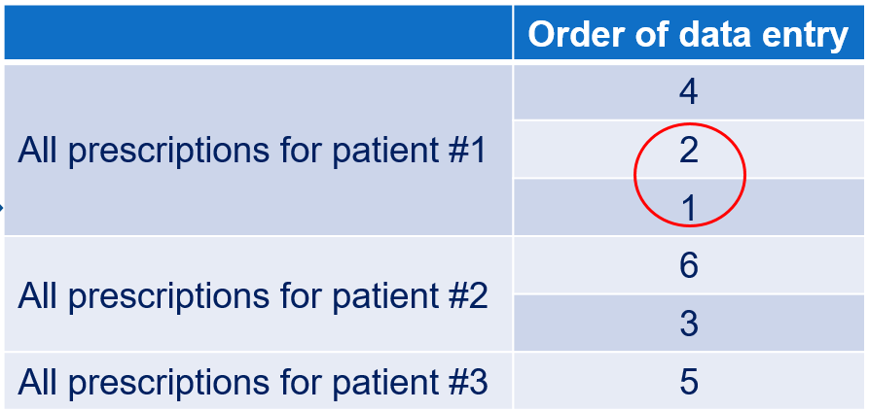
A Nationally Representative Drug Utilization Study of OxyContin in Children Age 17 Years and Younger
Inpatient EMR – Meditech
Outpatient EMR – Centricity
Data Manipulation was required to aid the study team in determining the order of participant and prescription data entry based on the following criteria:
Identify the most recent OxyContin prescription recorded for an inpatient or an outpatient, then
Identify the patient who received this prescription
Enter ALL OxyContin prescriptions the patient received in the study period
Proceed to the next most recent OxyContin prescription received by a different patient and repeat the process.

Slide 67
A Nationally Representative Drug Utilization Study of OxyContin in Children Age 17 Years and Younger
Describe process w/o CDW
Time Crunch
If done manually
Basic report from MEDITECH
MRNS & prescription date & time & dose
Basic report from Centricity
MRNS & prescription date & time & dose
Comprehensive list of Oxycontin prescriptions would require merger & then resort
Patient matching is complex

Slide 68
Implementation of Post-Partum Depression Screening in a General Pediatric Clinic

Slide 69
Implementation of Post-Partum Depression Screening in a General Pediatric Clinic
CQI project with administrative outcome measures
Investigators requested recurring reports to:
monitor compliance with utilization of the PHQ-9 screener at select appointments
assess the prevalence of PPD in new mothers
Inclusion criteria: well child check appointments for children ages 1 day to 6 months of age.
Variables provided:
Medical record number
Date of service
Provider name
Screened performed (Y/N) & date
Declination of screen
Score
Severity
Summary
Resources Provided
Comments
Count of previous screens administered
Last screen date
henry-intubate-1

Slide 70
PST-ADHD
Proactive Stimulant Titration in Attention Deficit/Hyperactivity Disorder: A pilot randomized control trial with implications for Developmental & Behavioral Pediatricians

Slide 71
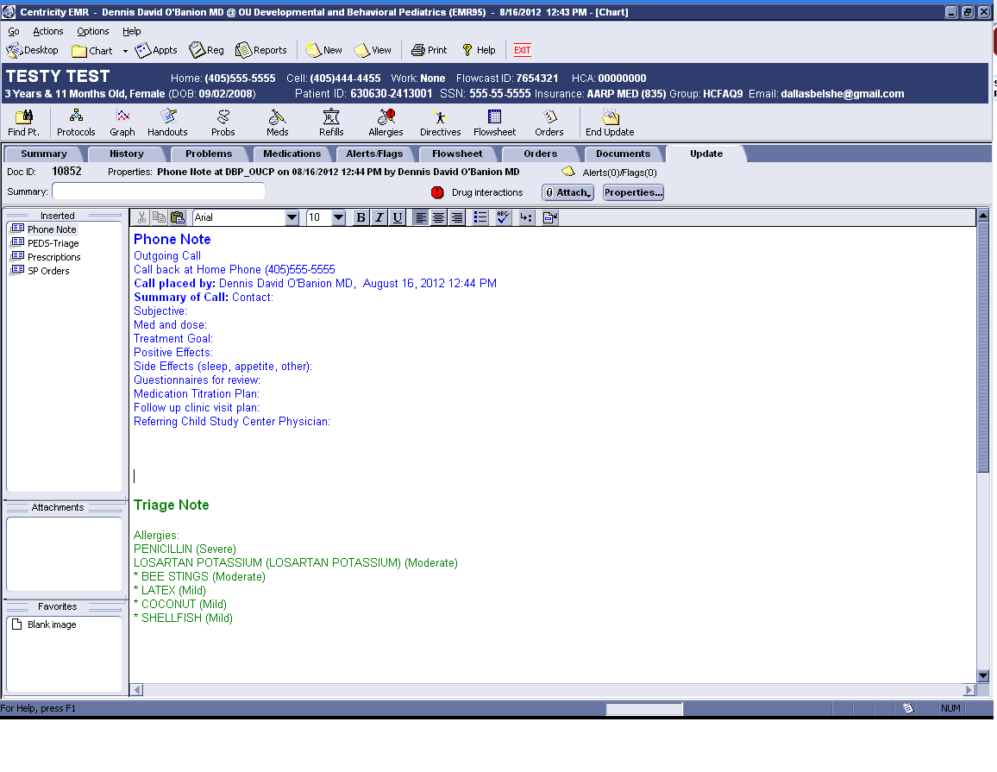
PST-ADHD trial
Required searching older records where some of the data were stored in unstructured notes
Built document extraction query to isolate all notes in single location for review
No need to review each chart separately
Built regex expressions to extract required data
Similar methods used to isolate images (e.g., radiology) and scanned documents

Slide 72

Notes:
Population health control/surveillance – identify disease susceptibility and optimize resource allocation.
We use data to know where the health burdens are, to signal anomalies and health risks, and to inform actions and interventions that can keep people safer and healthier. Our understanding of the public’s health is only as good as the data we have, and CDC works around the clock to get the right information into the right hands at the right time.
Opioid surveillance example:
With the rapidly evolving opioid overdose epidemic, ED data can serve as an early warning system, alerting communities to changes in prevalence of overdoses and permitting a timely, informed, and localized response that could facilitate a more rapid and coordinated response including targeting of resources (e.g., increase naloxone supply to affected areas), and issuance of emergency health alerts or advisories. EDs also can serve as a point of intervention for persons who experience an overdose and are at higher risk for a subsequent overdose. Educating ED physicians and staff members about appropriate services for immediate care and treatment and post-overdose protocols are important to preventing future overdoses among their patients. ED physicians could assess history of prescription drug use during care by accessing data from prescription drug monitoring programs and provide education to patients. Post-overdose protocols can help prevent subsequent overdose by providing naloxone and connecting patients with case management services or peer navigators to help link them into treatment and harm reduction services, including syringe services programs (12). Opioid overdoses continue to increase in most jurisdictions, and rapid response efforts and a multisectoral approach are needed to reduce and prevent overdoses and their associated morbidity and mortality.

Slide 73

Notes:
California-based Kaiser Permanente discovery of adverse drug effects and subsequent withdrawal of Vioxx
Kaiser Permanente connected clinical and cost data to provide crucial data set that led to the discovery of adverse drug effects and subsequent withdrawal of the drug Vioxx from the market.

Slide 74
Future Applications: Personalized/Precision Medicine

Slide 75
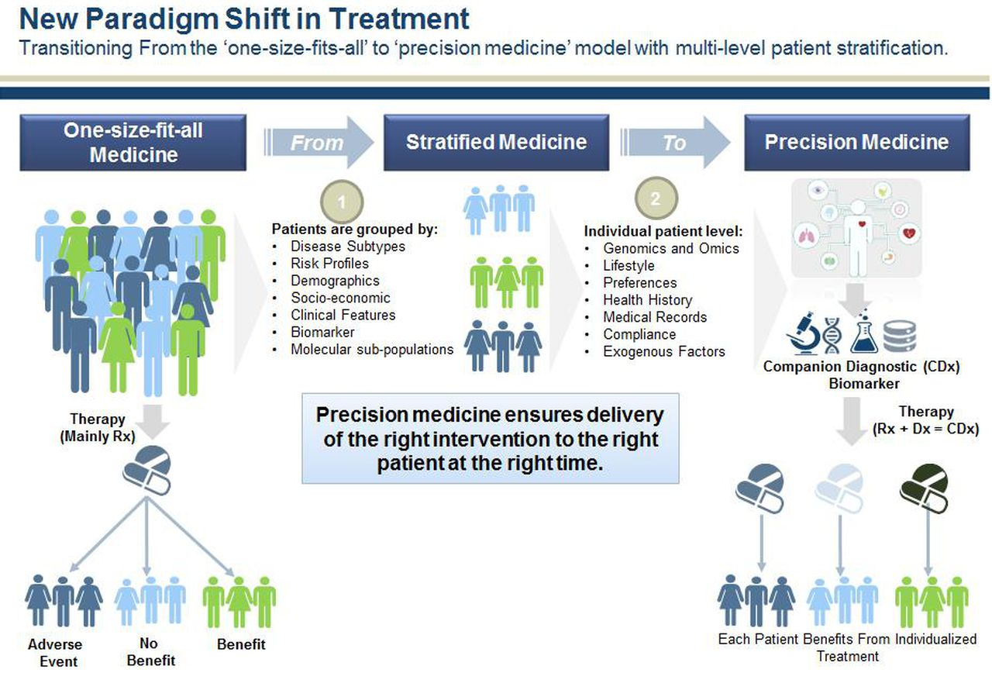
Notes:
Personalized Care, precision medicine- identify which treatments work for whom
Even more importantly is how these technologies are helping to create a new scientific revolution in which platforms like The Cancer Genome Atlas and the Materials Genome Initiative comb through far more data than a person ever could, detect patterns and open up new possibilities.
Yet what's truly amazing is that very little of this was viable even a decade ago and we've done little more than scratch the surface up till this point. In the future, it seems clear that our technology will advance to where even the highly unlikely becomes a sure bet.

Slide 76

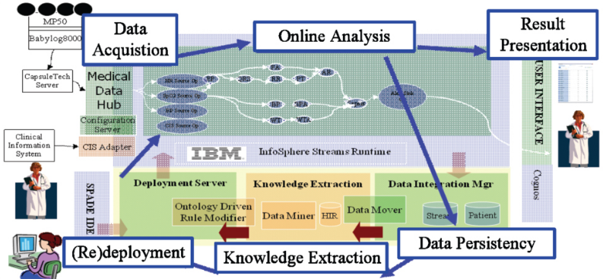


Notes:
Toronto’s Hospital for Sick Children, the University of Ontario Institute of Technology (UOIT) in Oshawa, Ont., and IBM Canada. To detect life-threatening infections for newborns. The hospital was able to predict the onset of nosocomial infections (a disease originating in a hospital) 24 hours before symptoms appeared.
Processing the 1256 readings per second it currently receives per patient. A note of a single reading every 30 or 60 minutes. Changes in heart rate, breathing and blood pressure in the earliest stages of infection are flagged, allowing physicians to spot early warnings and administer antibiotics sooner. Provide real-time analysis to help clinicians to predict more quickly potential negative changes in an infant’s condition.
Data stored to allow doctors to look for common factors to make more accurate predictions about a baby’s condition. The team is looking at studying the electrical activity of the brain. Recently, went live with a 200-bed NICU at a hospital in Shanghai, China, a 100-bed neonatal unit in Shenzhen, China. In the planning stages for another NICU in Canada, as well as one in Australia.

Slide 77
Mathematica
Assessing a Clinical Quality Measure for ADHD of Symptom Change in Order to Detect Symptom Reduction and to Examine Differences Across Clinics
Notes:
This is an example of where we were allowed to compete for funding because we had the CDW infrastructure.

Slide 78
Mathematica: Clinical Quality Measure for ADHD
Assist ONC with the continued development, electronic specification, testing and maintenance of an electronic clinical quality measure (eCQM)
OUHSC provided input and patient-level data to assess scientific acceptability (reliability and validity), importance (performance gap), feasibility, and usability of a clinical quality-of-care measure, which may be used in federal quality measurement programs.
Enrollment Criteria:
Pediatric patients 4 - 18 years of age,
A visit during the measurement period,
Active diagnosis of ADHD
Documented mean inattentive and/or hyperactive baseline subtype scores

Slide 79
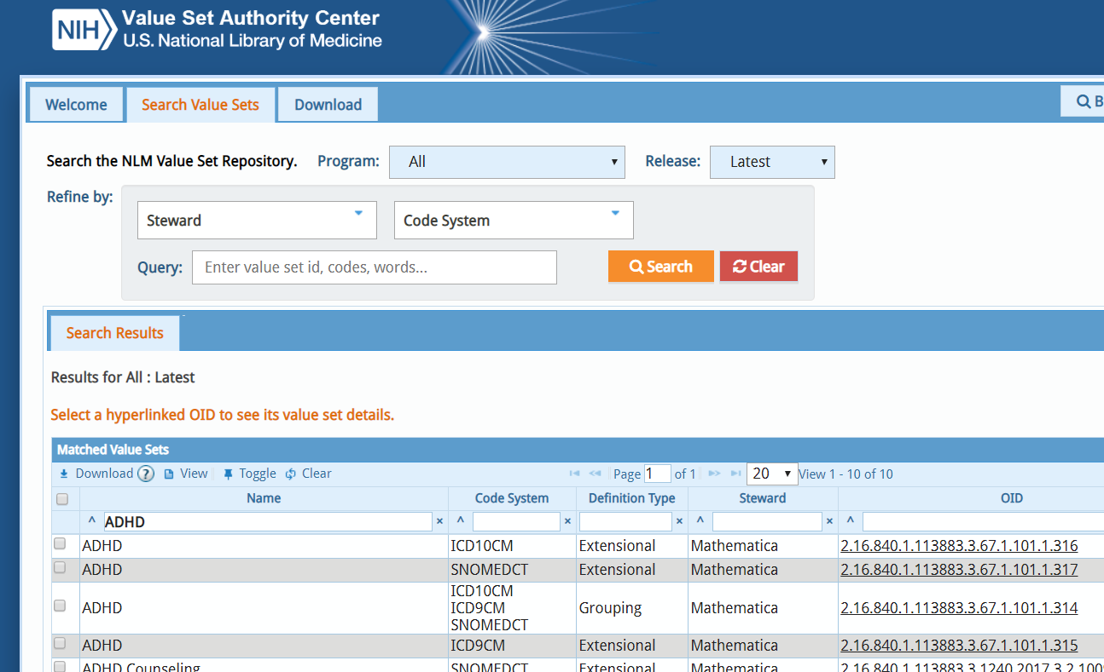
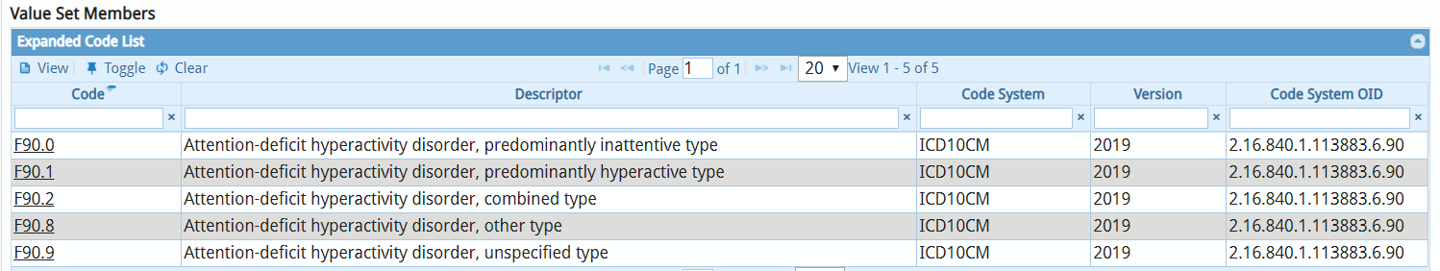
Mathematica
This project required the application of value sets, defined as lists of codes and corresponding terms, from NLM-hosted standard clinical vocabularies (SNOMED, RxNorm, LOINC, and others) that define clinical concepts to support interoperable health information exchange.

Slide 80
Pharmacist-led T2DM Care
Long-term Clinical Outcomes of Pharmacist-led Care in Type 2 Diabetes Mellitus
truong-diabetes-1

Slide 81
Pharmacist-led T2DM Care
This was a multi-center, retrospective cohort study.
Primary Aim: To determine the long-term clinical outcomes of pharmacist-led care in comparison to non-pharmacist led care in type 2 diabetes.
Change in HgbA1c from start date up to 5 years of follow-up
Time to patient-specific HgbA1c goal
Duration of HgbA1c at or below patient-specific goal from initial attainment of goal until loss of goal
Percentage of time at which HgbA1c is at or below patient-specific goal
Yearly completion of select components of the comprehensive diabetes medical evaluation
Included patients will be followed for a 5-year period.
Enrollment Criteria:
Patients ages 18 years or greater
Initial appointment for management of Type II DM between 1-1-2008 and 12-31-2011
Patients are excluded if pregnant, if continuous care is not maintained for a period of 9 months, or if initial HgbA1c <= 7.0%.
truong-diabetes-1
Notes:
Here’s a clinical outcome project that has very little overlap with the projects discussed so far. We’ve found that the CDW supports a broad range of departments, outcomes, and scopes.

Slide 82
Pharmacist-led T2DM Care
For each cohort, six tables were provided using 4 main-stem sources:
A list of included patients and relevant demographics
Unique 5-year study period triggered by initial Type II DM management
A comprehensive appointment history
Active diagnoses
Active medications
Clinical outcomes to include HbgA1c, blood pressure, diabetic eye and foot exams, influenza and pneumococcal vaccines, lipid profile, and nephropathy
truong-diabetes-1

Slide 83
Future Applications: Disease Surveillance & Learning Health Systems
Notes:
The “Learning Health Systems” part is a passion of Matt Atkins, the head of Informatics at OU Physicians I mentioned in the previous slide

Slide 84
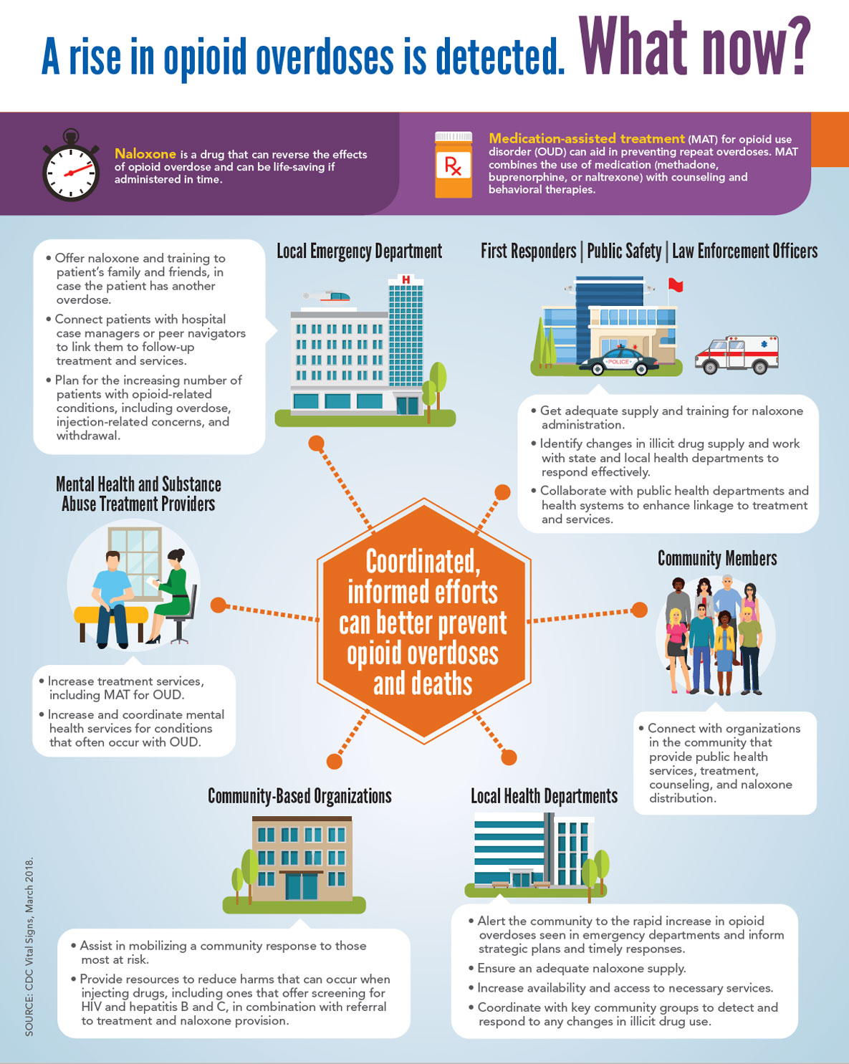

Slide 85
Diabetic Transitions of Care
An assessment of a newly initiated transitions of care clinic at an academic health center
truong-transition-clinic-1
Notes:
Examine the transition from hospital to clinic. Requires integration of our two major EMRs and of the clinic billing system..

Slide 86
Diabetic Transitions of Care
Retrospective, observational study
Study Aims:
all-cause hospital admissions 1 year pre- and post-transitions of care clinic intervention
30-day all-cause readmissions pre- and post-transitions of care clinic intervention
all-cause emergency department (ED) utilization 1 year pre- and post-transitions of care clinic intervention
cost analysis of an existing transitions of care clinic
Enrollment criteria:
All patients, ages 18 and older
Transition of Care (ToC) Clinic patient between June 12, 2017 and January 12, 2018.
truong-transition-clinic-1

Slide 87
Diabetic Transitions of Care
Evaluate the frequency of hospital admission, 30-day readmission, and ED utilization 1 year prior to each patient’s initial ToC visit in comparison to the same outcomes after the patient’s initial visit in the ToC service.
Demographic variables: inpatient and outpatient medical record number, patient name, account number, date of birth, gender, race, ethnicity, insurance, and zip code
Inpatient variables: date of admission, date of discharge, length of stay, discharge diagnoses (1-50), DRG, place of service, charges, payments
Outpatient variables:
Appointments: date and time, type, reason, provider, duration, status
Medications: medication name, generic name, start date, stop date
Diagnoses: ICD code, code description, start date, stop date
Invoices: invoice number, location of care, provider name, charge, payments, diagnoses, cpt codes
truong-transition-clinic-1

Slide 88
Diabetes Care & Transition Studies
Required most comprehensive collection of data from wide variety of sources
Centricity EMR, Centricity Business (registration, scheduling, billing), MEDITECH EMR, MEDITECH Business (billing)
Would have required enormous time and effort to collect and aggregate manually
Clinical outcomes were tricky
Lab results get stored in multiple obs terms (e.g., micro albumin: 1of 20 obs terms with different units, so requires a lot of clean-up)
Complex measurement specifications (e.g., diabetic nephropathy: defined with micro albumin or with an order to nephrology clinic or …)
truong-transition-clinic-1

